Slide 1


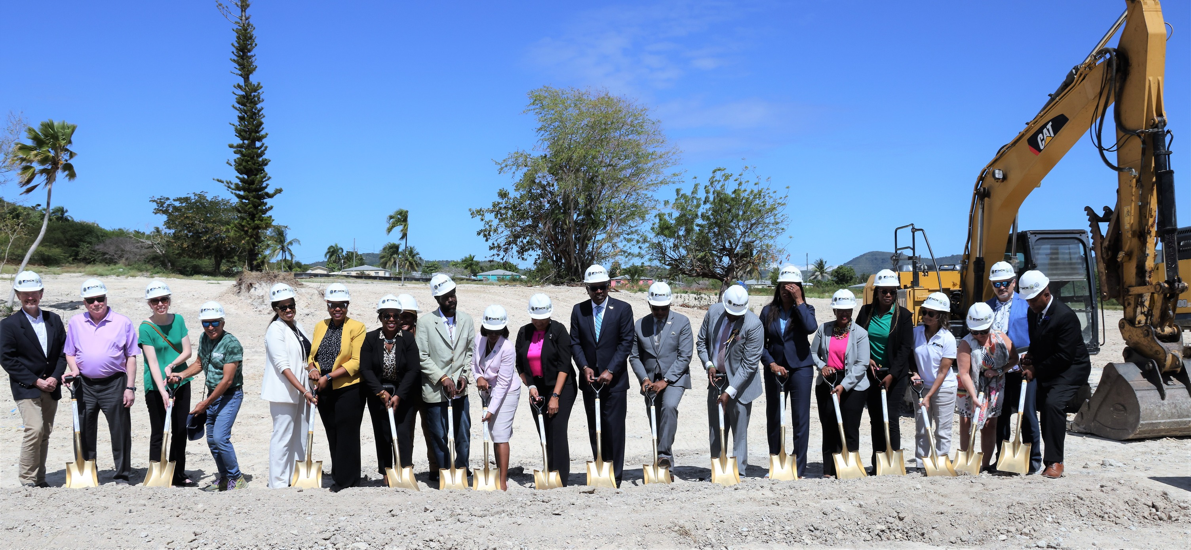
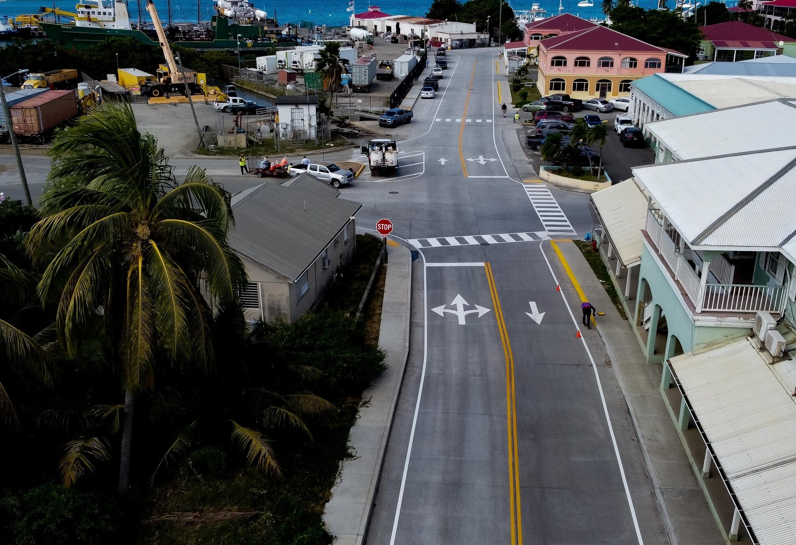
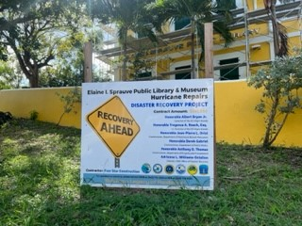
U.S. Virgin Islands
OFFICE OF DISASTER RECOVERY
Revenue Estimating Conference
March 14, 2023
Adrienne L. Williams-Octalien
Director

Slide 2
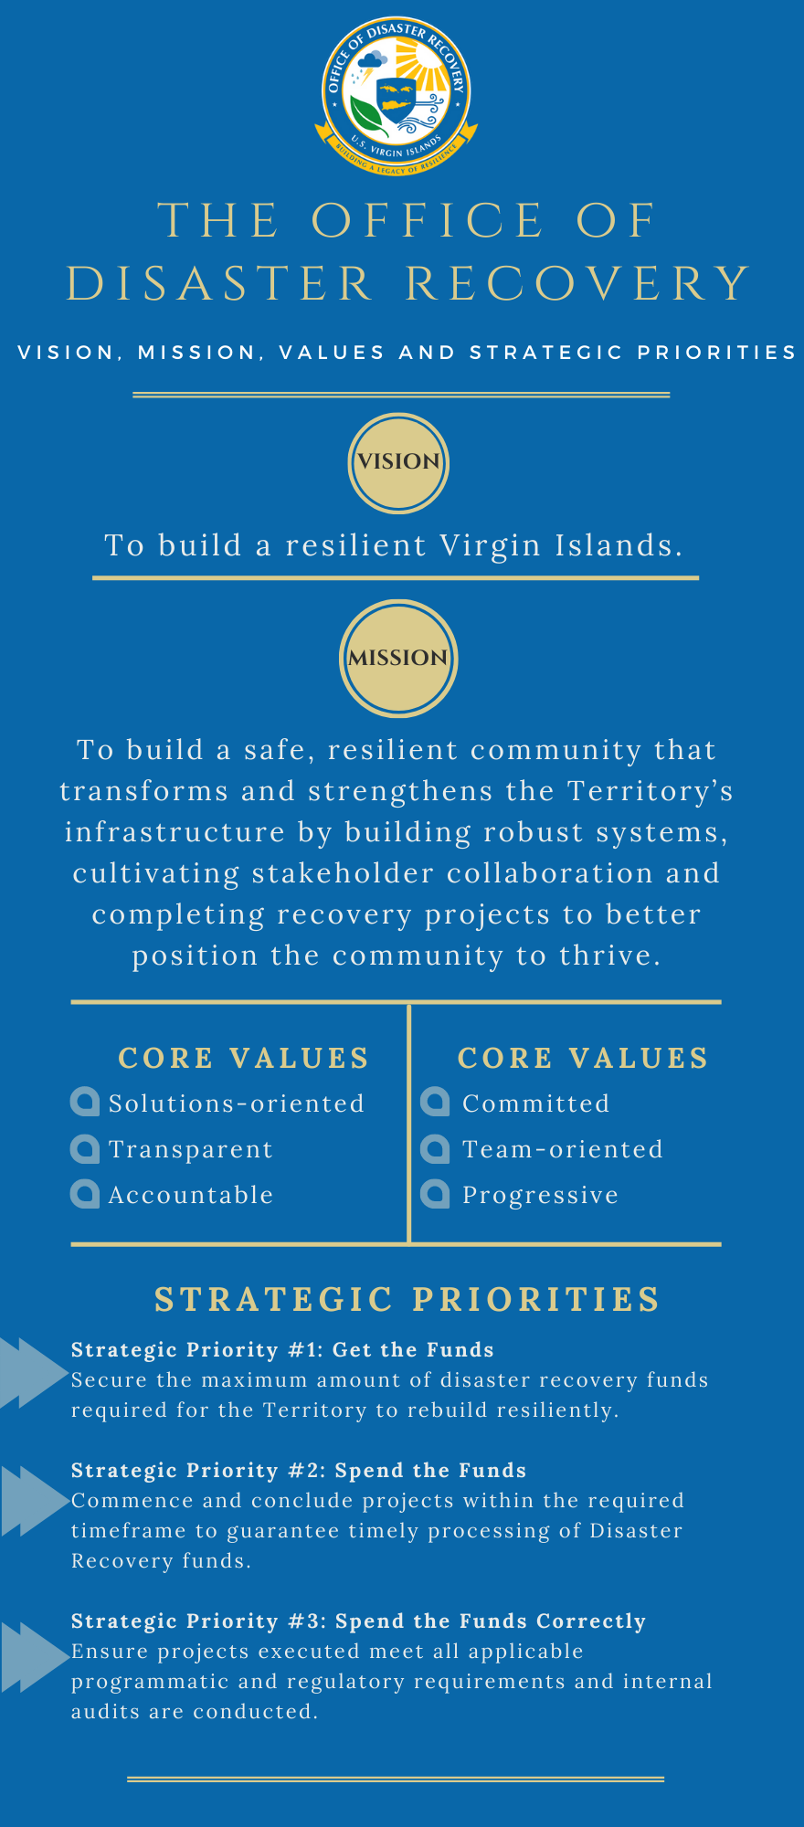

Get Funds
Foster vital federal partnerships (FEMA, HUD, DOT)
Spend the Funds
Track project Statuses
Spend Correctly
Conduct Audits & Monitoring
Manage recovery consultants
Resolve recovery issues
Provide resources to manage and progress projects
Process vendor payments
Track GRT
Implement capacity improvement measures through trainings, workshops, outreach and additional support staff
Secure Funding for projects
Host status meetings and issue notifications to encourage expenditure of funds
Communications
  Website (www.usviodr.com)
  Social Media
Recovery In Focus
Press Releases

Slide 3
Disaster Recovery: Funding Snapshot

Slide 4
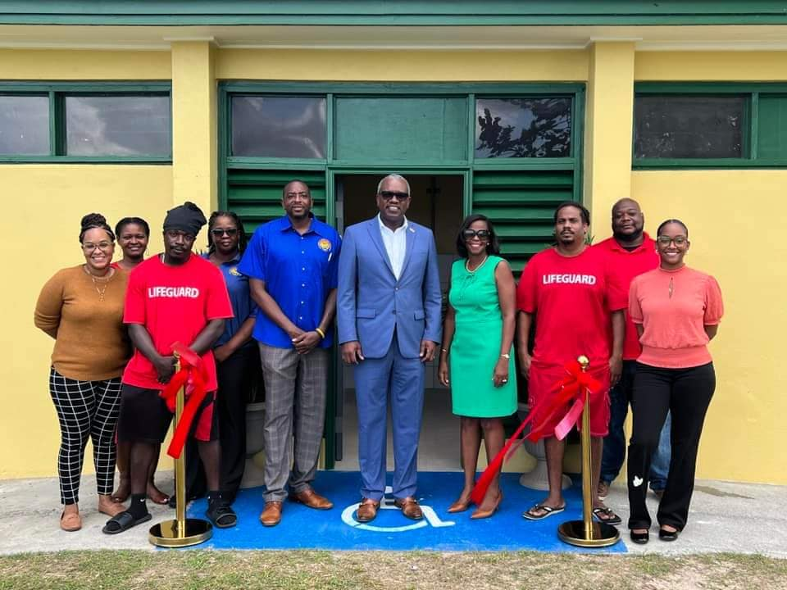
Revenue Estimation Assumptions
The U.S. Virgin Islands will collect tax revenues from funded disaster projects based on the contractor’s gross receipts.
FY2024 and FY2025 budgeted revenue projections are based on disaster related capital projects (>$500k) that are both currently obligated and those that are expected to be obligated through FY25 across main funding sources.
Over 200 obligated and soon to be obligated projects valued at over $4.3B are expected to impact the FY24 and FY25 budgeted revenue projections with expected expenditures of $560.2M in FY24 and $570M in FY25
Recovery projects also impact other forms of revenue such as licenses, permits, fees, housing, and spend within the community and economy.

Slide 5

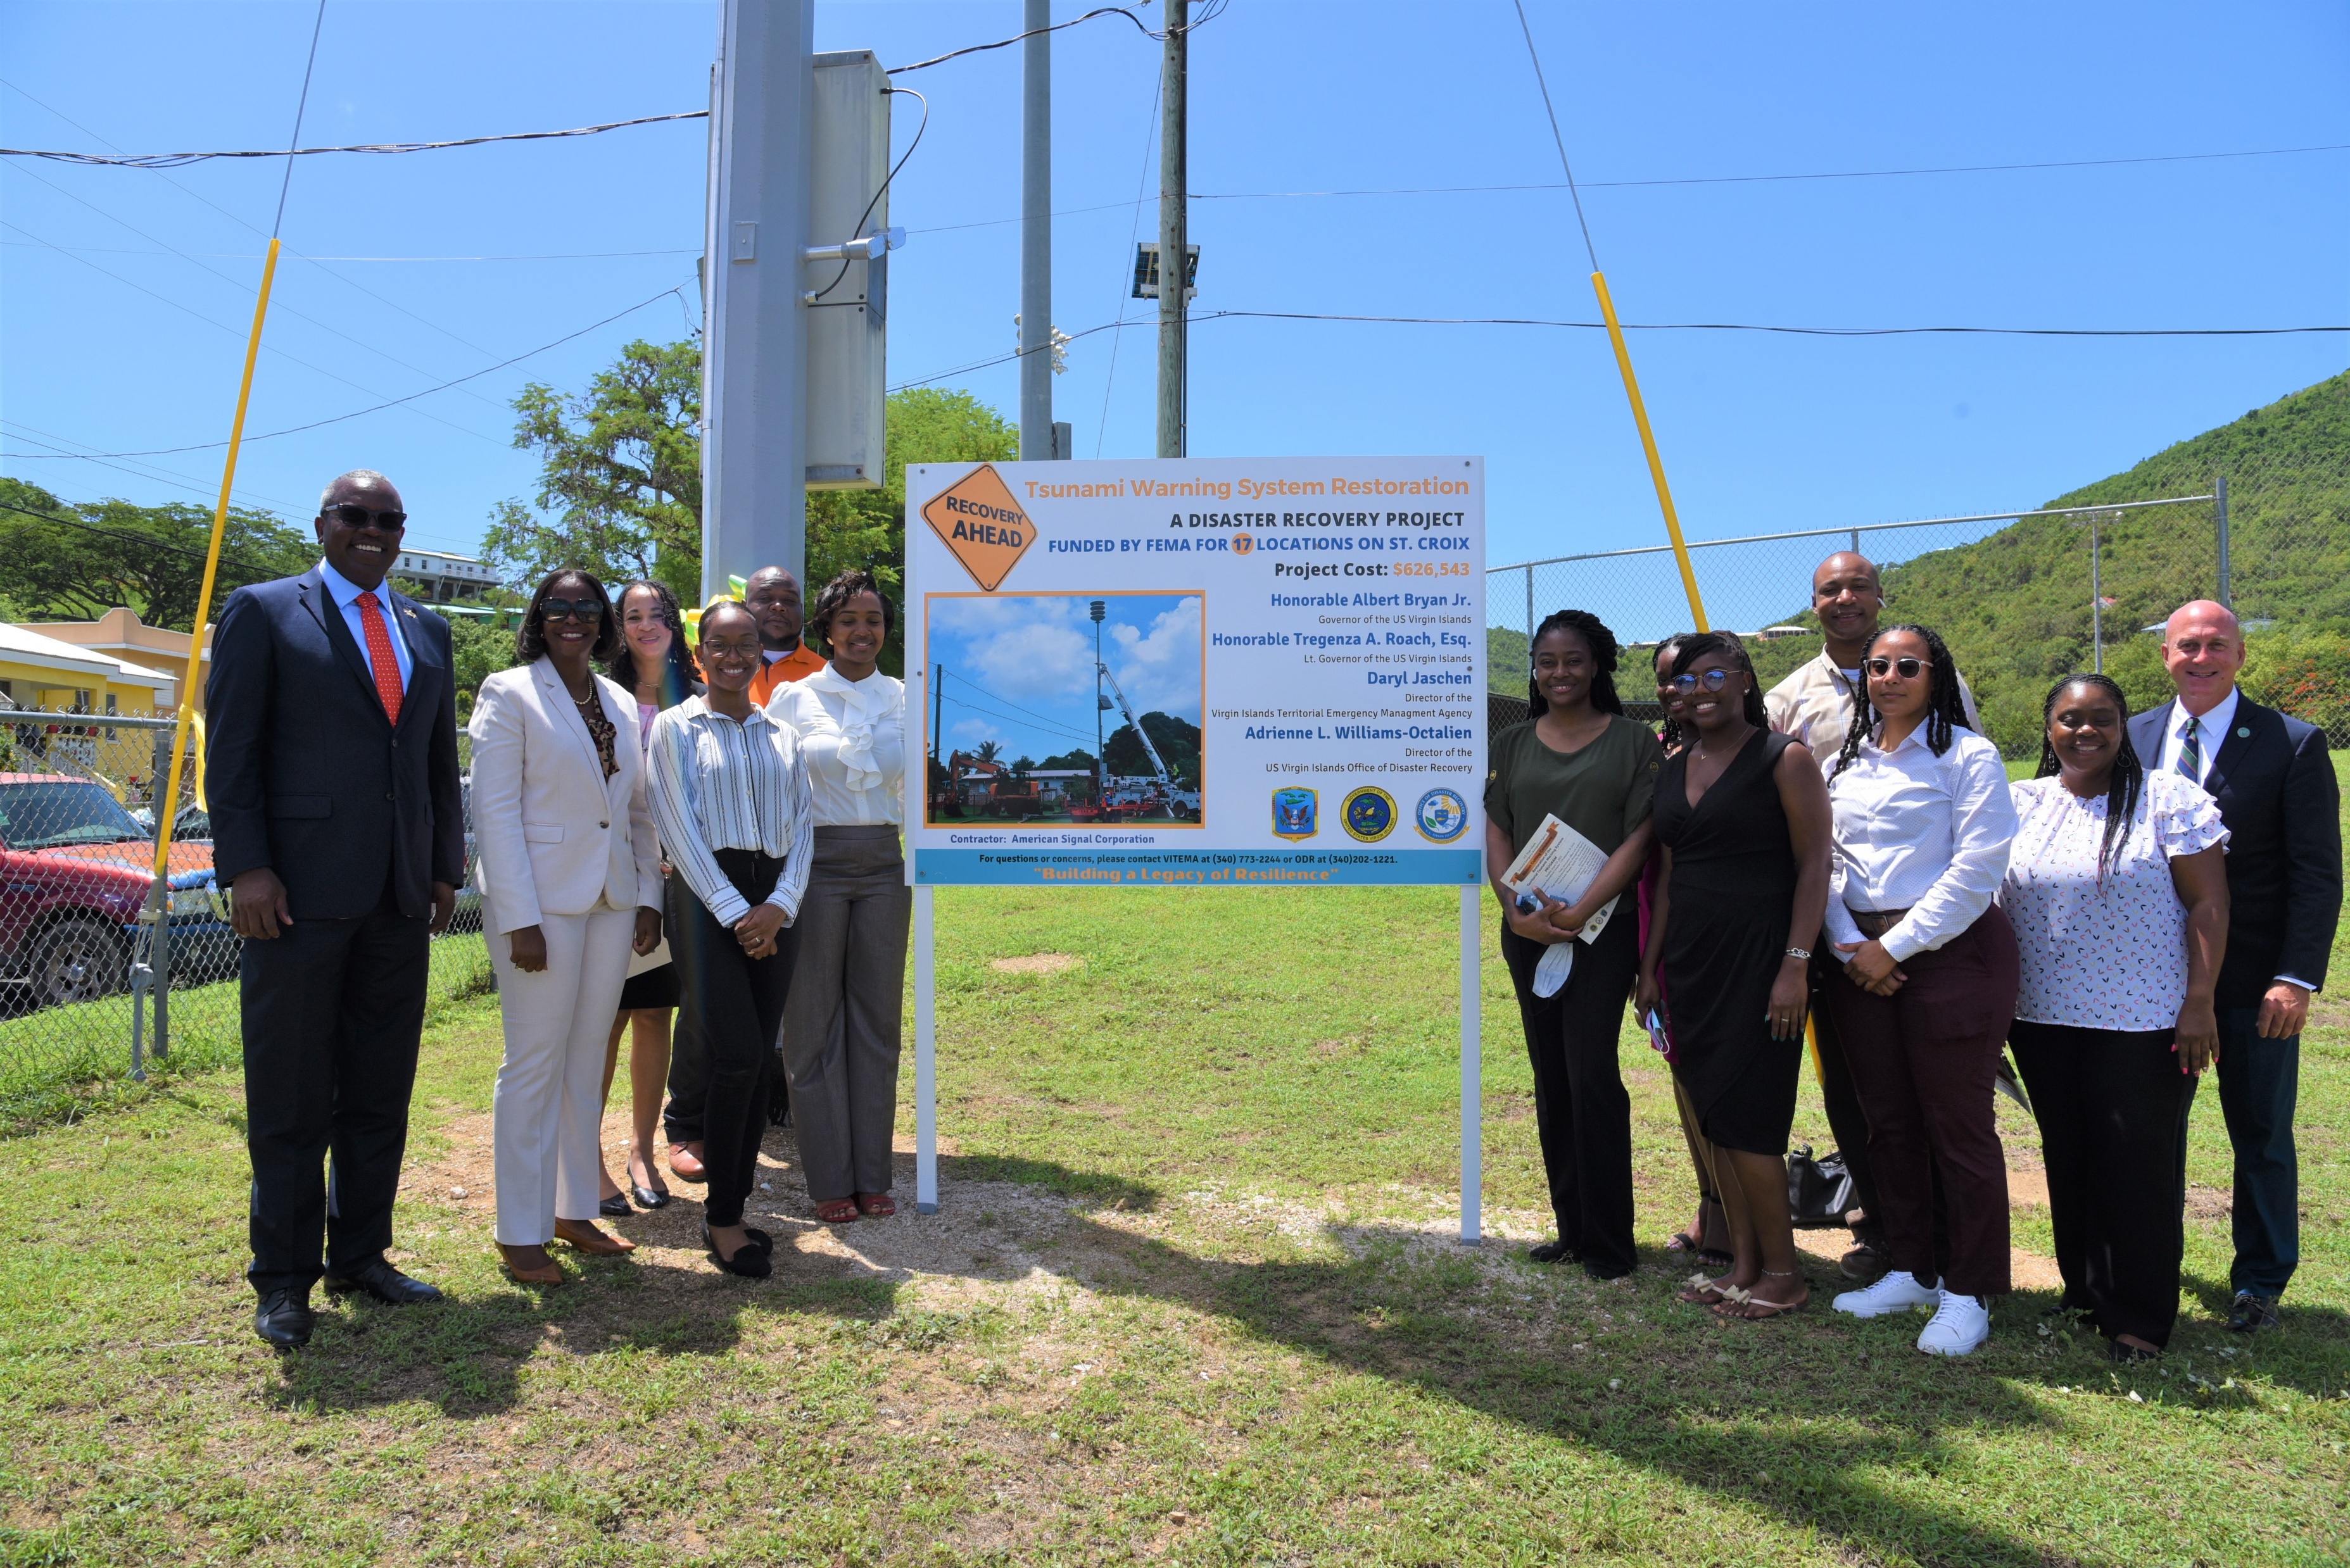
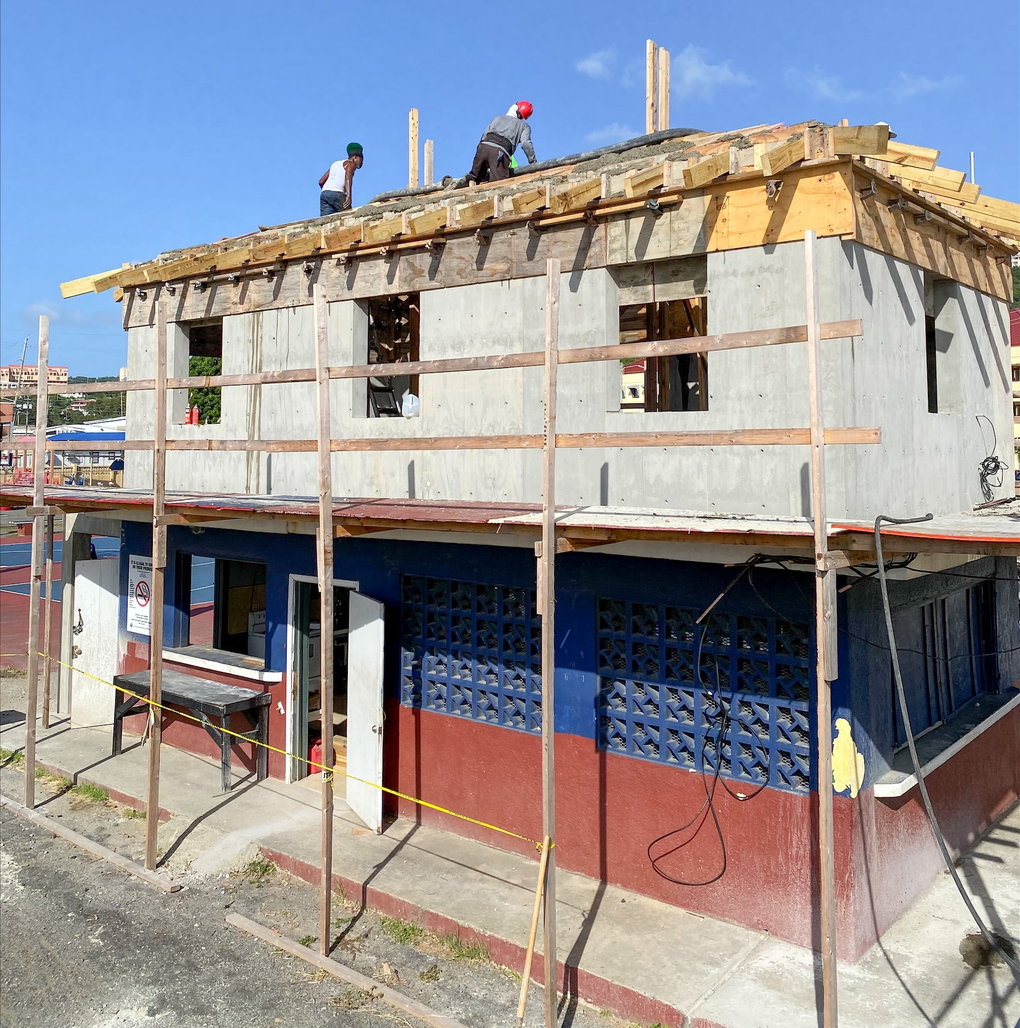
Revenue Performance –Actuals
Actuals FY2023 Q1
Funding Source | Q1 2023 - Projections | Q1 2023 – Actuals
PA | $ 4,186,071 | $ 2,018,878
HMGP | $ 170,450 | $ 135,171
CDBG-DR | $ 241,578 | $ 574,449
FHWA-ER | $ 146,742 | $ 85,965
TOTAL | $ 5,196,982 | $ 2,814,463

Slide 6
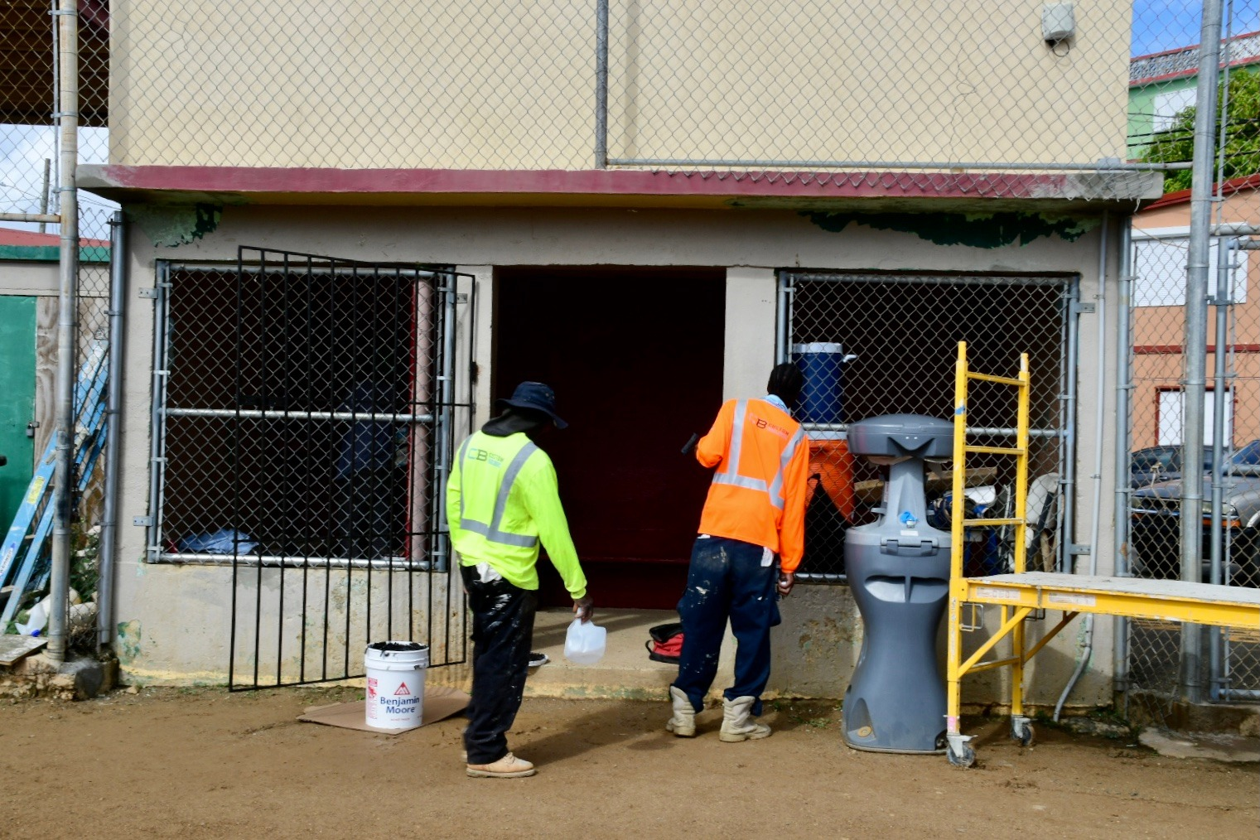
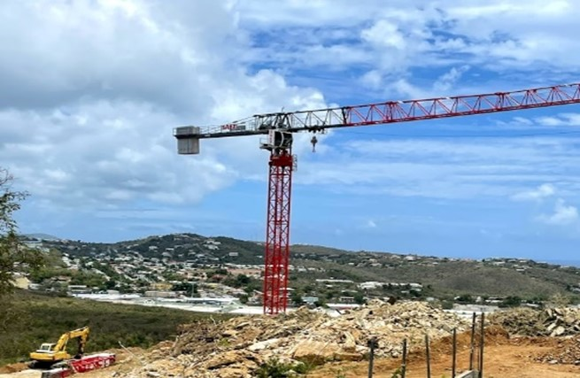
Expenditure Projections– FY2024 & FY2025
FY2024
Funding Source | FY 2024 Projections
PA | $ 412,170,620
HMGP | $ 33,343,372
CDBG-DR | $ 66,934,707
Other Funds | $ 46,744,510
FHWA-ER | $ 6,655,000
Multiple | $ 1,017,666
TOTAL | $ 566,865,875
FY2025
Funding Source | FY 2025 Projections
PA | $ 419,000,288
HMGP | $ 64,800,092
CDBG-DR | $ 66,435,703
Other Funds | $ 17,404,863
FHWA-ER | $ 4,105,000
Multiple | $ 2,397,689
TOTAL | $ 574,143,635

Slide 7

Revenue Estimate Snapshot – FY2024 & FY2025
FY2023 and FY2024 Total Estimated Revenue
FY24 | $ 28,343,249
FY25 | $ 28,707,182
Revenue Breakdown
FY2024 |  | FY2025
Revenue Category | GRT FY 2024 Projections | Funding Source | GRT FY 2025 Projections
PA | $ 20,608,531 | PA | $ 20,950,014
HMGP | $ 1,667,169 | HMGP | $ 3,240,005
CDBG-DR | $ 3,346,735 | CDBG-DR | $ 3,321,785
Other Funds | $ 2,337,225 | Other Funds | $ 870,243
FHWA-ER | $ 332,750 | FHWA-ER | $ -
Multiple | $ 50,883 | Multiple | $ 119,884
TOTAL | $ 28,343,294 | TOTAL | $ 28,707,182
Revenue Summary
Significant Recovery Projects - FY 24 & 25
WAPA Electrical Improvement Projects - Randolph Harley New Generation - Undergrounding Projects DSPR Parks and Facilities
Major Education Projects - Arthur Richards Junior High - CAHS Demolition
Several Road Projects
Health & Human Services Facilities - Charlotte Kimelman Cancer Center - Charles Harwood Medical Complex - Territory Head starts

Slide 8
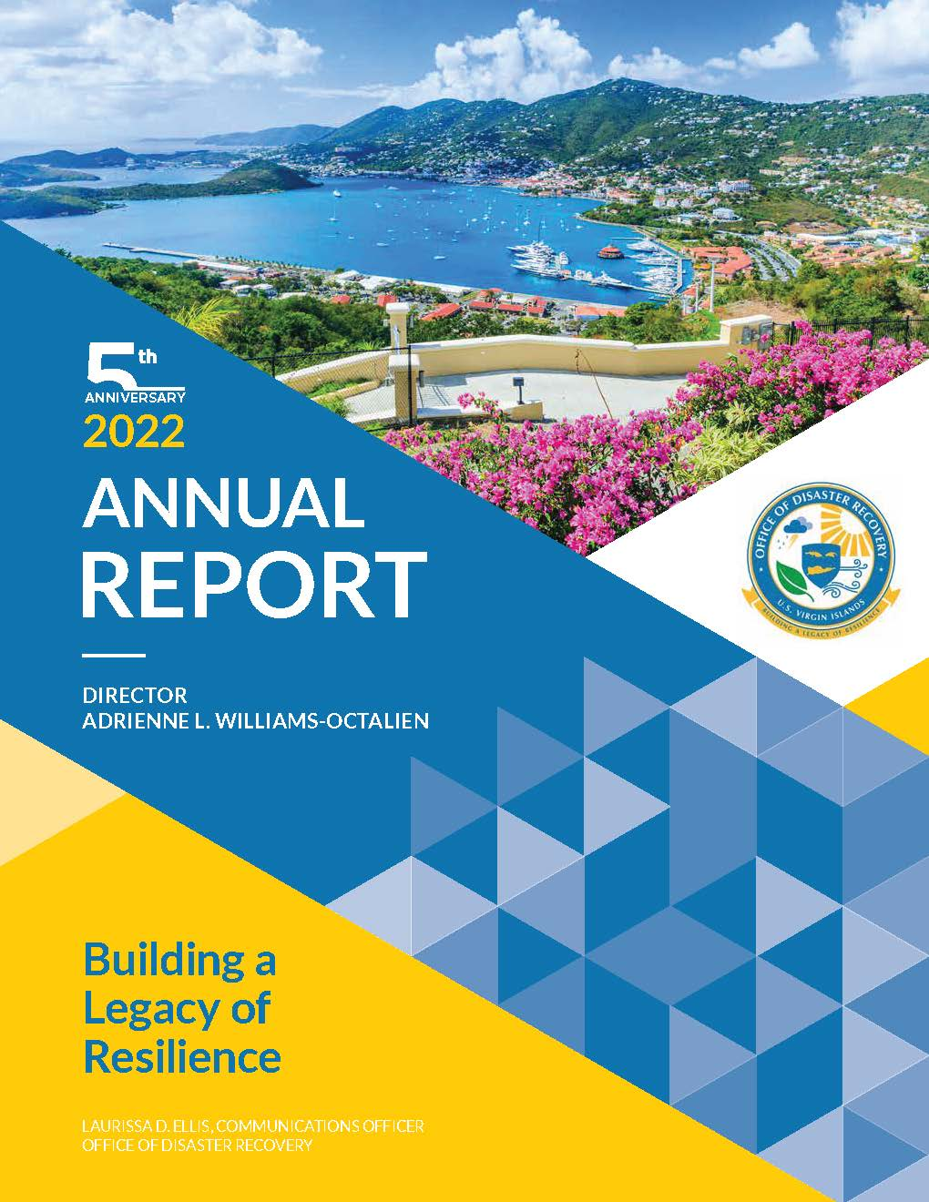
Thank You!
Any Questions?
Contact:
Director, Adrienne L. Williams-Octalien
Governor’s Authorized Representative (GAR)
Phone:
(340)202-1221
Website:
www.usviodr.com
Email:
info@usviodr.com

