Slide 1
2024 SPRING
ESTIMATING REVENUE
CONFERENCE
PRESENTED BY: BERNESHA LIBURD
OFFICE OF THE GOVERNOR
BUREAU OF ECONOMIC RESEARCH
WWW.USVIBER.ORG | BERDATA@BER.VI.GOV
PHONE: 340-693-4375 | WWW.USVIBER.ORG | BERDATA@BER.VI.GOV

Slide 2
USVI REAL
Gross Domestic Product
Bureau of Economic Research (BER) in collaboration with the Bureau of Economic Analysis (BEA).

Slide 3
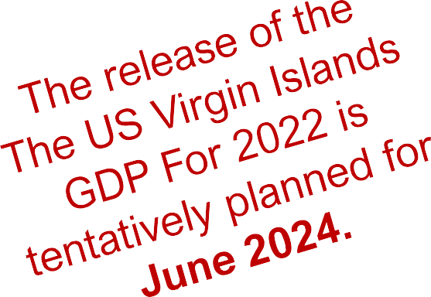
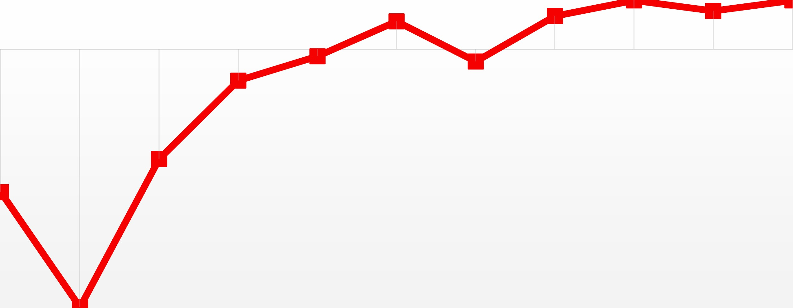
REAL GROSS DOMESTIC PRODUCT (GDP) GROWTH RATE (%) FROM 2011-2021
6
4
2
0
-2
-4
-6
-8
-10
-12
-14
-16
-18
2021
2.8
 | 2011 | 2012 | 2013 | 2014 | 2015 | 2016 | 2017 | 2018 | 2019 | 2020 | 2021
USVI Real GDP Annual % change. | -8.2 | -14.8 | -6.3 | -1.8 | -0.4 | 1.6 | -0.7 | 1.9 | 2.8 | 2.2 | 2.8

Slide 4
Let’s discuss VISITOR ARRIVALS
This presentation provides an overview of visitors to the U.S. Virgin Islands by cruise and air travel.

Slide 5
USVI TOTAL VISITOR ARRIVALS BY DISTRICT FISCAL YEARS 2017 to 2024 FEBRUARY YTD
2,600,000
2,100,000
Total Visitor Arrivals
1,600,000
1,100,000
Cruise
600,000
Air
100,000
 | FY 2017 | FY 2018 | FY 2019 | FY 2020 | FY 2021 | FY 2022 | FY 2023 | FY 2024
 |  |  |  |  |  |  |  | Feb. YTD
Air Visitor Arrivals | 784,556 | 399,217 | 637,876 | 187,750 | 826,823 | 800,069 | 756,947 | 369,023
Cruise Visitor Arrivals | 1,921,939 | 1,186,188 | 1,480,932 | 442,027 | 245,695 | 1,021,182 | 1,594,796 | 779,359
Total Visitor Arrivals | 2,706,495 | 1,585,405 | 2,118,808 | 629,777 | 1,072,518 | 1,821,251 | 2,351,743 | 1,148,382

Slide 6
AIR VISITOR ARRIVALS BY DISTRICT FISCAL YEARS 2017 to 2024 FEBRUARY YTD
900,000
800,000
700,000
600,000
500,000
400,000
300,000
200,000
100,000
0
Air STT
Total Air Arrivals
Air STX
 | FY 2017 | FY 2018 | FY 2019 | FY 2020 | FY 2021 | FY 2022 | FY 2023 | FY 2024
 |  |  |  |  |  |  |  | Feb. YTD
Air Arrivals STX | 154,377 | 140,929 | 167,357 | 38,682 | 142,553 | 141,584 | 152,098 | 82,064
Air Arrivals STT | 630,179 | 258,288 | 470,519 | 149,068 | 365,664 | 658,485 | 604,850 | 286,959
Total Air Arrivals | 784,556 | 399,217 | 637,876 | 187,750 | 508,217 | 800,069 | 756,947 | 369,023

Slide 7
CRUISE VISITOR ARRIVALS BY DISTRICT FISCAL YEARS 2017 to 2024 FEBRUARY YTD
2,000,000
1,500,000
Cruise STT/STJ
Cruise Visitor Total
1,000,000
500,000
Cruise STX
0 | FY 2017 | FY 2018 | FY 2019 | FY 2020 | FY 2021 | FY 2022 | FY 2023 | FY 2024
 |  |  |  |  |  |  |  | Feb. YTD
Cruise STX | 138,362 | 56,345 | 64,833 | 17,444 | 3,841 | 83,478 | 169,044 | 49,705
Cruise STT/STJ | 1,783,577 | 1,129,843 | 1,416,099 | 424,583 | 26,353 | 937,704 | 1,425,752 | 729,684
Cruise Visitor Total | 1,921,939 | 1,186,188 | 1,480,932 | 442,027 | 30,194 | 1,021,182 | 1,594,796 | 779,389

Slide 8
Let’s discuss Accommodations
Such as hotels, guest houses, and villas.

Slide 9
GUEST REGISTRATIONS
FISCAL YEARS 2016-2024 MARCH YTD
1,100,000
1,000,000
989,939
988,751
900,000
800,000
736,274
732,968
700,000
614,532
600,000
499,558
527,515
500,000
469,894
420,326
400,000
367,205
300,000
200,000
FY 2015
FY 2016
FY 2017
FY 2018 FY 2019 FY 2020
GUEST REGISTRATIONS
FY 2021
FY 2022
FY 2023
FY 2024
FISCAL YTD MAR

Slide 10
ACCOMMODATION OCCUPANCY RATES OCTOBER 2022 to MARCH 2024
100.0
90.0
88.2
77.6
80.8
80.0
76.6
71.0
70.0
64.9
63.2
59.3
61.5
60.8
61.5
61.0
60.0
55.5
52.2
50.0
44.1
44.1
41.1
43.1
40.0
30.0
20.0
10.0
0.0
Oct-22
Nov-22
Dec-22
Jan-23
Feb-23
Mar-23
Apr-23
May-23
Jun-23
Jul-23
Aug-23
Sep-23
Oct-23
Nov-23
Dec-23
Jan-24
Feb-24
Mar-24

Slide 11
Let’s Discuss Economic Indicators
There are three categories of building permits: private residential, private non-residential, and public building permits. The overall value of the building permits is calculated by totaling these categories.

Slide 12
BUILDING PERMITS BY VALUE($) FISCAL YEARS 2017 TO 2024 FEBRUARY YTD
$450,000
$400,000
$350,000
$300,000
$250,000
$200,000
$150,000
$100,000
$50,000
$-
Public Building Permit Value
Private Non-Residential Permit Value Private Residential Value
Total Building Permit Value
Millions
FY 2014 | FY 2015 | FY 2016 | FY 2017 | FY 2018 | FY 2019 | FY 2020 | FY 2021 | FY 2022 | FY 2023 | FY 2024
Total Building Permit Value ^{YTD} FEB
Public Building Permit Value | $27,565 | $15,263 | $23,286 | $38,076 | $34,802 | $95,389 | $50,965 | $115,199 | $34,568 | $56,961 | $10,577
Private Non-Residential Permit Value | $53,824 | $63,743 | $95,860 | $76,262 | $38,697 | $29,021 | $37,419 | $62,756 | $27,913 | $85,262 | $18,218
Private Residential Value | $90,485 | $87,640 | $34,006 | $32,503 | $110,905 | $221,257 | $162,883 | $208,344 | $154,377 | $168,529 | $80,978
Total Building Permit Value | $171,874 | $166,646 | $153,152 | $146,841 | $184,404 | $345,667 | $234,777 | $386,300 | $216,858 | $310,751 | $109,772

Slide 13
Let’s Discuss the Consumer Price Index (CPI)
According to the Bureau of Labor Statistics (BLS), consumer prices in the United States increased by 3.4% in the year 2023.

Slide 14
USVI INFLATION RATES (%) 2018-2023
12.0%
2022
9.8%
10.0%
2021
2023
8.4%
8.6%
8.0%
2018
6.4%
2020
5.7%
6.0%
2019
3.8%
4.0%
2.0%
0.0%
2018
2019
2020
2021
2022
2023

Slide 15
USVI INFLATION RATES (%)
BY MAJOR CATEGORIES 2018-2023
20.0%
15.0%
10.0%
5.0%
0.0%
-5.0%
 | Food | Housing | Tranportation | Alchoholic Bev. | Medical | Recreation | Ed. & Comm. | Other Goods
2022 | 14.2 | 12.2 | 17.4 | 10.9 | 6.2 | 6.5 | 4.1 | 2.3
2023 | 7.3 | 10.7 | -2.2 | 9.7 | 3.0 | 3.8 | 8.5 | 10.0

Slide 16
USVI INFLATION RATES (%)
FOR SELECTED ITEMS IN MAJOR CATEGORIES 2022-2023
140
127.9
120
100
81.0
80
67.7
52.7
56.4
57.5
56.3
60
50.3
52.1
56.3
49.3
41.6
41.6
45.3
43.8
39.7
47.9
40
35.8
35.8
35.8
24.2
22.7
20
0
POULTRY
BEEF
EGGS
FRUITS & VEG.
RENT
ELECTRICITY
APPLIANCES
GAS
TIRES
TUITION
CELL PHONE
FOOD
HOUSING
TRANSPORTATION
ED. & COMM.

Slide 17
USVI 2024-2025
ECONOMIC OUTLOOK VIRGIN ISLANDS
Despite economic challenges faced by the world, the US Virgin Islands' economy is exhibiting a robust and sustained growth trajectory. This can be attributed to a flourishing tourism sector, an improving labor market, and substantial business investments. The USVI's government has played a crucial role in bolstering economic growth, particularly in the face of the pandemic. Most economic indicators have shown consistent growth year-to- date, reflecting steady economic growth. However, it is pertinent to note that global headwinds and geopolitical tensions are still prevalent and could pose risks to the positive outlook in the months ahead.

Slide 18
Thank you!
Any Questions?
www.usviber.org
OFFICE OF THE GOVERNOR
BUREAU OF ECONOMIC RESEARCH
WWW.USVIBER.ORG | BERDATA@BER.VI.GOV
Phone: 340-693-4375 | www.usviber.org | berdata@ber.vi.gov

