Slide 1
Virgin Islands
Economic Development Authority
Revenue Estimating Conference
May 2024
The Buccaneer, Inc.
VIEDC Beneficiary
Notes:
Type your notes

Slide 2
Virgin Islands
Economic Development Commission
Fiscal Years 2025-2026 Revenue Projections
Tramway Properties, Inc. VIEDC Beneficiary
Notes:
Type your notes

Slide 3
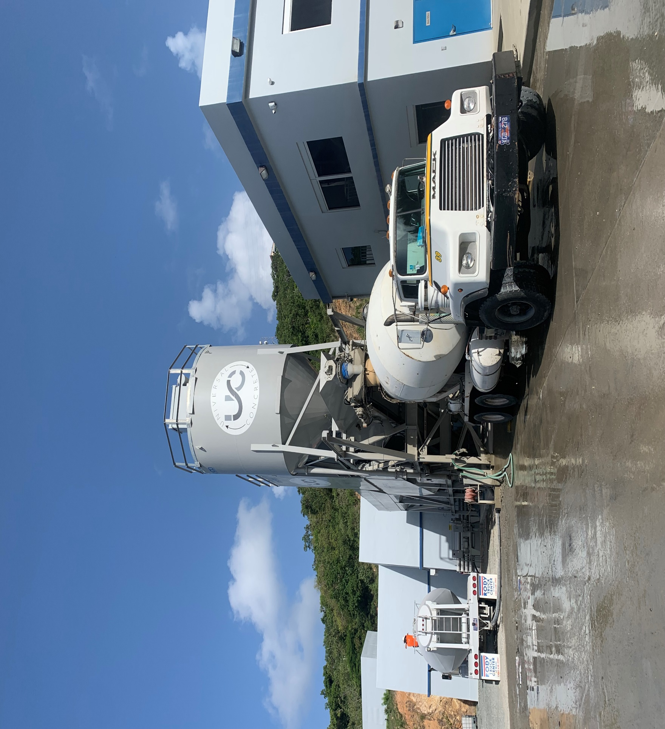
WHAT IS ECONOMIC DEVELOPMENT?
The International Economic Development Council (IEDC) defines economic development “as a program, group of policies, or activity that seeks to improve the economic well-being and quality of life for a community, by creating and/or retaining jobs that facilitate growth, enhance wealth and provide a stable tax base.”
Business Investment
Employment
Land
Capital
Entrepreneurship
Wages
Rents
Interests
Profits
Goods
Services
Universal Concrete, LLC
VIEDC Beneficiary
Households
Notes:
Type your notes

Slide 4
FACT
Tax incentives are intended to spur economic growth that would not have otherwise occurred.
Capital Investments
Charitable Contributions
The Territory starts at a net zero position
10% Income Tax Paid to the Territory
Employment Wages & Benefits for VI Residents
100% Income Tax on Global Income
Notes:
Type your notes

Slide 5
BENEFITS TO THE TERRITORY
BENEFICIARIES MUST PAY
NOTE ON INCOME TAX
10% on VIEDC Corporate Income
Income Tax
Payroll Tax
Effective Tax Rate: 2.3% (based on tax rate of 21% and 10% surcharge)
10% on VIEDC Personal Income
Effective Tax Rate: 3.7% (based on exemption and partial exemption as provided in 29 V.I.C. § 713d on Distributions, Dividends and/or Interest Withholding)
Full Tax Rate on Global Non-VIEDC Personal Income
Stamp Tax
Property Tax*
No tax-incentive/benefits are taken on income derived from services provided in the USVI (Designated Services)
*If not used for the approved business.
Notes:
Add note to this slide

Slide 6
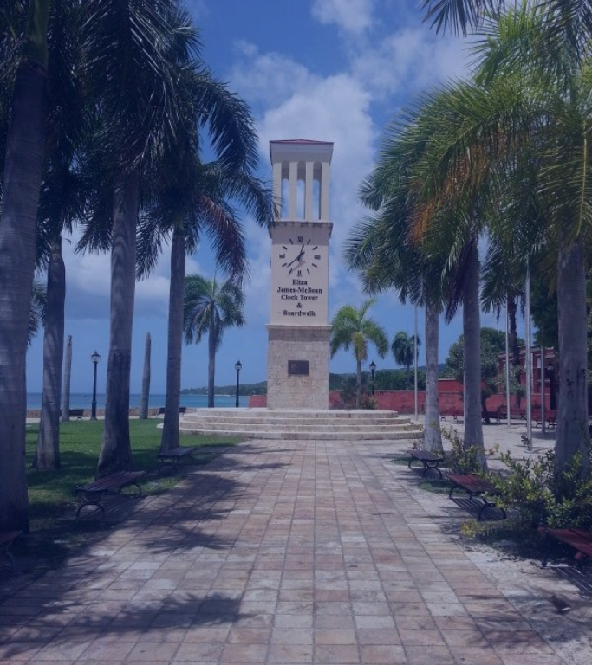
BENEFITS TO THE TERRITORY
LOCAL INVESTMENT
Minimum Capital Investment of $100,000
Purchase Goods and Services Locally from Virgin Islands Businesses
Notes:
Type your notes

Slide 7
BENEFITS TO THE TERRITORY
EMPLOYMENT
Hire a Minimum of 5 (Designated Service Businesses (DSB) only) or
10 Full-Time Employees
(All Other Businesses)
80% of Full-Time Positions Filled by Virgin Islands Residents
20% Management/ Supervisory/Technical Positions Filled by Virgin Islands Residents
Pension Plan, Medical Insurance and Paid Time Off
(Vacation, Sick, Donated, & Other Leave Required by Law)
Management Training Programs
Tuition Reimbursement
Notes:
Type your notes

Slide 8
BENEFITS TO THE TERRITORY
STATUTORY REQUIREMENTS & CHARITABLE CONTRIBUTIONS
Contribution of $3000 Annually to the Board of Education
Contribution of $2500 Annually to the Department of Labor
Charitable Contributions Annually to Local Non-profits, 501(c)3 Entities and/or Government Programs
Educational Assistance (including Internship Opportunities and Scholarships) of which 55% must be paid directly to the VI Department of Education
Alpine Group USVI, LLC VIEDC Beneficiary
Notes:
Type your notes

Slide 9
HISTORICAL NEW APPLICANT
STATISTICS
Notes:
Type your notes

Slide 10
Notes:
Type your notes

Slide 11
ECONOMIC IMPACT ANALYSIS
Impact of the Beneficiaries of the EDC Program for the Period 2013-2015
19.3
$9.7
$309
Full-Time Equivalent Jobs
Average: 6,436/year
Charitable Contributions
Average: $3.23M/year
Taxes and Duties Paid
Average: $103M/year
THOUSAND
MILLION
MILLION
$1
$1.5
Territory-Wide Economic Output Average: $500M/year
Wages & Salaries
Average: $339M/year
BILLION
BILLION
Source: USVIEDA Economic Impact Analysis conducted by UVI's Institute for Leadership & Organizational Effectiveness (2019)
Tree Limin’ Extreme, LLC
VIEDC Beneficiary
Notes:
Type your notes

Slide 12
ACTIVE BENEFICIARIES
Notes:
Type your notes

Slide 13
TOTAL TAXES & DUTIES PAID
The average annual taxes and duties paid from 2016-2020 was $93M.
Notes:
Type your notes

Slide 14
FISCAL IMPACT TO THE USVI ECONOMY
Total Taxes Paid by VIEDC Beneficiaries
Taxes Paid on Global Income by Principals
USVI Economy
Notes:
Type your notes

Slide 15
FY 2025-2026 ANTICIPATED REVENUES
Year 2
$10M
Year 1
$5M
Notes:
Type your notes

Slide 16
CONTACT US
www.usvieda.org
340.714.1700
340.773.6499
info@usvieda.org
Notes:
Type your notes

