Slide 1
Government of the Virgin Islands Spring Revenue Estimating Conference Tuesday, May 7, 2024
Department of Planning & Natural Resources
Jean-Pierre L. Oriol
Commissioner
Notes:
Good morning Governor Bryan, good morning Lt. Governor Roach, Director O’Neal and my fellow cabinet members, good morning Senator President Francis, members of the 35th Legislature, and to all the attendees present in person and following us via the live stream….

Slide 2
MISSION STATEMENT
Notes:
DPNR is the resource management or regulatory agency of the GVI that ensures the protection of our natural, cultural and historic resources. Our six regulatory programs institute application and permit procedures for compliance with federal and territorial air, water, flood, building, endangered and historic resources.

Slide 3
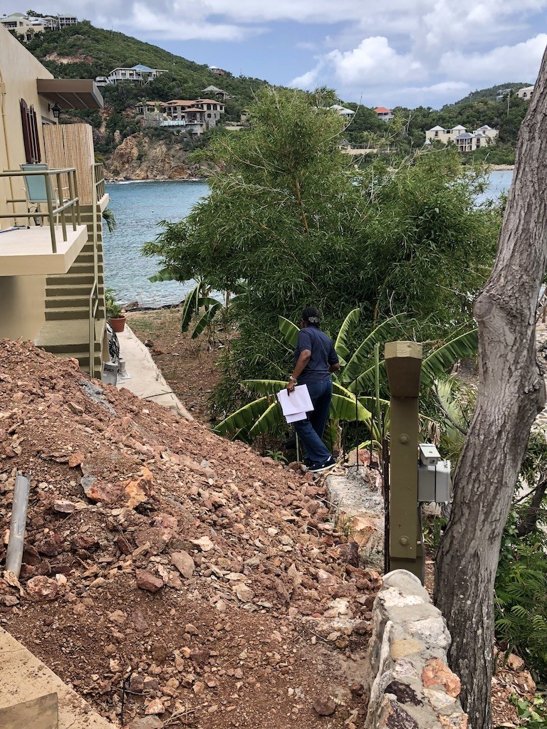
DPNR COLLECTIONS
DPNR collections are done primarily through the collection of fees for permitting, inspections, leasing and registrations
Collections are earmarked for both General Fund and number of Special Funds
Total Collections combined average between around $7M
($6.4M in FY 2021, $7M in FY 2022, and $7.9M in 2023; $7.3M estimated for FY 2024)

Slide 4
SESSION: General Fund Fiscal Years 2022 - 2025
Categories | FY2022 Actuals | FY2023 Actuals | FY 2024 Estimated | FY2024 Actuals | FY2025
Demolition Permits | $ 59,127.81 | $ 52,318.86 | $ 49,355.39 | $ 16,807.64 | $ 53,600.69
Building Permits | $ 2,063,405.96 | $ 2,296,272.96 | $ 2,141,736.35 | $ 1,195,374.37 | $ 2,167,138.42
Sign Permits | $ | $ 200.65 | $ 5,853.90 | $ 545.74 | $ 3027.27
Electrical Permits | $ 231,409.37 | $ 241,328.07 | $ 237,506.34 | $ 121,232.60 | $ 236,747.93
Sanitary Permits | $ 102,707.66 | $ 88,618.66 | $ 64,841.66 | $ 50,658.97 | $ 85,389.33
Earth Change Permits | $ 59,523.40 | $ 69,704.60 | $ 66,718.11 | $ 27,054.78 | $ 65,315.37
Occupancy Permits | $ 18,174.00 | $ 17,983.25 | $ 18,657.08 | $ 8,910.00 | $ 18,271.44
Flood Permits | $ 14,645.65 | $ 14,650.00 | $ 15,774.27 | $ 6,455.80 | $ 15,023.31
Over Collection | $ 94.50 | $ 15.00 | $ 40.83 | $ 0 .82 | $ 50.11
Mechanical Fees | $ 5,860.43 | $ | $ 3,784.72 | $ 1,015.40 | $ 4,822.57
Penalty on Return Check | $ 870.22 | $ 8,298.72 | $ 3,113.60 | $ 427.82 | $ 4,094.18
Violation Fines | $ 8,180.00 | $ 1,116.00 | $ 3,598.67 | $ | $ 4,298.22
Permits Municity – 3% | $ | $ 67,499.64 | $ 67,499.64 | $ 41,072.17 | $ 67,499.64
Photocopies | $ 35.00 | $ 18.00 | $ 24.17 | $ 27.50 | $ 25.72
Placard Fees | $ 3,005.09 | $ 625.00 | $ 2,290.36 | $ 1,483.00 | $ 1,973.48
Total | $ 2,567,039.09 | $ 2,843,999.41 | $ 2,783,584.30 | $ 1,471,066.61 | $ 2,687,357.06
Notes:
Doing something different this year for the conference – providing the last two years of actual collections and comparing to our estimates for this fiscal year to see if we’re trending in the right direction. FY ‘21 collected $2,542,059; in ‘22 we collected $2,567,039 for FY ‘23 collected $2.84M, almost $400k more… residential construction costs were up significantly last fiscal year

Slide 5
SPECIAL FUNDS
Fiscal Years 2022 - 2025
Notes:
Next several slides provide an overview of the various special funds associated with the execution of the mandates of the Department.

Slide 6
Special Funds Categories
FUND | FY 2022 Actuals | FY2023 Actuals | FY2024 Estimated | FY 2024 Actuals | FY2025
Air Pollution Control (Title V) | $ 330,191.35 | $ 119,013.00 | $ 200,657.45 | $ 1.00 | $ 216,620.60
VI Coastal Protection | $ 134,276.56 | $ 160,938.37 | $ 206,405.79 | $ 215,980.00 | $ 222,290.92
Underground Storage Tank | $ 12,750.00 | $ 9,250.00 | $ 15,333.33 | $ 6,500.00 | $ 12,444.44
Fish and Game | $ 405,849.82 | $ 393,899.89 | $ 387,162.60 | $ 64,173.74 | $ 395,637.44
Legal Publications Revolving | $ 8,166.00 | $ 5,468.00 | $ 6,618.66 | $ 2,570.00 | $ 6,756.22
Libraries & Museum Revolving | $ 81,399.04 | $ 113,128.00 | $ 77,945.68 | $ 83,493.98 | $ 90,824.24
Program Income | $ 138,365.00 | $ 1,950,526.78 | $ 711,468.59 | $ 212,363.62 | $ 933,453.46
Natural Resources Reclamation | $ 3,386,451.57 | $ 2,346,523.15 | $ 2,921,664.52 | $ 1,557,231.40 | $ 2,862,041.58
Total | $ 4,497,449.34 | $ 5,098,747.19 | $ 4,527,256.62 | $ 1,933,269.72 | $ 4,740,068.90
Notes:
FY 2021 total special fund collections was $3,888,820; FY 2022 was ~$4.5M or 15% increase from FY 2021; in FY 2023 we collected ~$5.1M or 13% increase from FY 2022

Slide 7
Virgin Islands Coastal Protection Fund
Categories | FY2022 Actuals | FY2023 Actuals | FY 2024 Estimated | FY2024 Actuals | FY2025
Pesticide Applications | $ 150.00 | $ 40,620.00 | $ 13,655.00 | $ 153,765.00 | $ 18,141.67
Air Pollution | $ 27,492.00 | $ 16,447.70 | $ 17,470.23 | $ 6,890.00 | $ 20,469.98
Well Permits/License | $ 1,795.00 | $ 480.00 | $ 1,148.33 | $ 500.00 | $ 1,141.11
Terminal Facilities | $ 44,505.00 | $ 49,910.00 | $ 49,605.00 | $ 25,620.00 | $ 48,006.67
Photocopies | $ 707.00 | $ 0.00 | $ 361.83 | $ 30.00 | $ 356.28
Notice of Violations | $ 10,600.00 | $ 7,000.00 | $ 5,900.00 | $ 1,000.00 | $ 7,833.33
Soil Boring | $ 1,570.00 | $ 250.00 | $ 1,156.67 | $ 740.00 | $ 992.22
Ground Water | $ 1,170.00 | $ 1,030.00 | $ 1,163.33 | $ 400.00 | $ 1,121.11
Solid Waste | $ 4,010.00 | $ 6,928.00 | $ 5,999.33 | $ 3,810.00 | $ 5,645.78
Medical Waste | $ 2,230.00 | $ 1,110.00 | $ 1,583.33 | $ 300.00 | $ 1,641.11
Water Pollution/TPDES | $ 40,047.56 | $ 37,162.67 | $ 25,736.74 | $ 22,925.00 | $ 34,315.66
Laboratory Certificate | $ | $ | $ | $ | $
Total | $ 134,276.56 | $ 160,938.37 | $ 206,405.79 | $ 215,980.00 | $ 222,290.92
Notes:
We are seeing a successful implementation of our new pesticide registration fee.

Slide 8
Legal Publication Revolving Fund
Categories | FY2022 Actuals | FY2023 Actuals | FY 2024 Estimated | FY2024 Actuals | FY2025
Zoning Amendment | $ 6,955.00 | $ 4,755.00 | $ 5698.33 | $ 2,560.00 | $ 5,802.78
Sub-Division | $ 1,211.00 | $ 713.00 | $ 912.33 | $ 10.00 | $ 945.44
Copies | $ | $ | $ 8.00 | $ - | $ 8.00
Total | $ 8,166.00 | $ 5,468.00 | $ 6,618.66 | $ 2,570.00 | $ 6,756.22
Notes:
Not much generation from the zoning map amendment requests. Application fees for this are $250

Slide 9
Fish and Game Fund
Categories | FY2022 Actuals | FY2023 Actuals | FY 2024 Estimated | FY2024 Actuals | FY2025
Boat Registration | $ 360,925.82 | $ 353,682.39 | $ 346,967.27 | $ 59,472.74 | $ 353,858.49
Fishing License (Tags) | $ 13,972.00 | $ 14,971.50 | $ 14,027.33 | $ 1,676.00 | $ 14,323.61
Fish House Rental | $ 30,785.00 | $ 22,677.00 | $ 25,065.33 | $ 2,825.00 | $ 26,175.78
Miscellaneous | $ 167.00 | $ 2,569.00 | $ 1,102.67 | $ 200.00 | $ 1,279.56
Total | $ 405,849.82 | $ 393,899.89 | $ 387,162.60 | $ 37,700.54 | $ 395,637.44
Notes:
Vessel and mooring registration is in the month of June, so we haven’t hit our peak yet. We will more than likely be in the red with respect to the fish markets as we have several vacant stalls for a myriad of reasons, and our expenses far outweigh our collections

Slide 10
Natural Resources Reclamation Fund
Categories | FY2022 Actuals | FY2023 Actuals | FY 2024 Estimated | FY2024 Actuals | FY2025
Lease | $ 2,634,569.81 | $ 1,842,356.98 | $ 2,358,445.41 | $ 1,456,178.56 | $ 2,278,457.40
Permits | $ 67,642.88 | $ 19,872.00 | $ 49,035.09 | $ 32,347.50 | $ 45,516.66
Mooring | $ 360,321.81 | $ 337,957.47 | $ 345,271.59 | $ 31,979.92 | $ 347,850.29
Anchoring | $ 30,061.59 | $ 27,760.00 | $ 30,046.01 | $ 12,476.76 | $ 29,289.20
Sub Rental | $ 25,359.40 | $ 7,912.65 | $ 22,543.71 | $ 2,764.94 | $ 18,605.25
Division of Permits 3% | $ 62,064.52 | $ 18,199.55 | $ 26,754.69 | $ 17.13 | $ 35,672.92
Notice of Violation | $ 78,814.50 | $ 78,814.50 | $ 69,010.52 | $ 20,641.59 | $ 91,814.03
Miscellaneous Fees | $ 127,617.06 | $ 13,650.00 | $ 20,557.49 | $ 825.00 | $ 14,835.83
Total | $ 3,386,451.57 | $ 4,209,127.06 | $ 2,921,664.51 | $ 1,557,231.40 | $ 2,862,041.58

Slide 11
SESSION: Upcoming Initiatives
Our Cruising Permit has been in effect for one year now. During FY 2023, we had multiple applications from mega yachts who frequented the territory during the winter season. As we increase our fleet this upcoming year, it will enable us to do more spot checks on the water for proper anchoring/cruising permits
In this fiscal year we will be executing a contract to revise penalties and fees within the Department. Many fees have not been updated since the 1980s, and in some instances, we cannot seek administrative penalties directly for violations (in these instances we must go through the Dept of Justice).

Slide 12
FUNDING TOTALS Fiscal Years 2023-2025
FUND | FY 2022 Actuals | FY2023 Actuals | FY2024 Estimated | FY2024 Actuals | FY2025 Estimated
General Fund | $2,567,039 | $2,843,999 | $2,783,584 | $1,471,066 | $2,727,278
Special Funds | $4,497,449 | $5,098,747 | $4,527,257 | $1,933,270 | $4,740,069
Total | $7,064,488 | $7,942,746 | $7,310,841 | $3,404,336 | $7,467,347
Notes:
FY 2021, total was $6,430,879

Slide 13
QUESTIONS
End of Session

