Slide 1












2026 SPRING
REVENUE CONFERENCE
MARCH 20, 2026

Slide 2
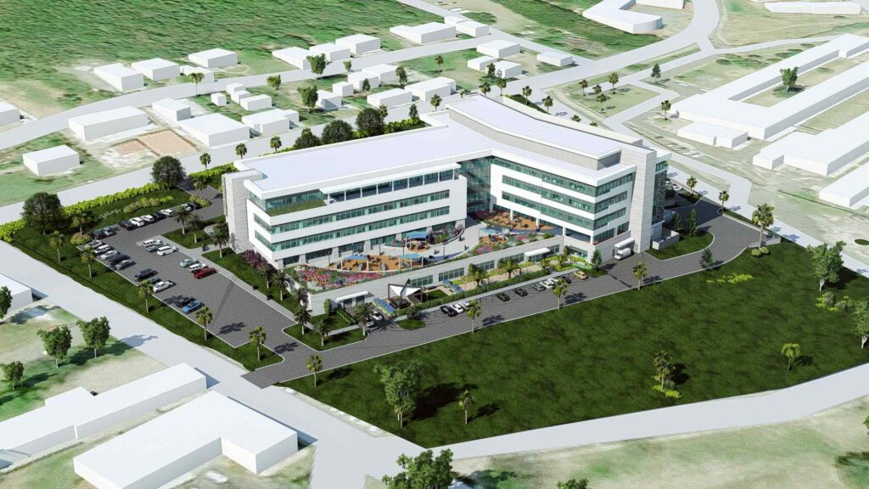


2026 SPRING
REVENUE ESTIMATING CONFERENCE
MARCH 20, 2026

Slide 3



MISSION STATEMENT
To administer and enforce the tax laws of the Virgin Islands.
STRATEGIC GOALS
    To promote voluntary compliance with the internal revenue tax laws
    To collect the tax revenues owed to the Government of the Virgin Islands.

Slide 4
GENERAL FUND COLLECTIONS
(Fiscal Years 2022 - 2026)

Slide 5

GENERAL FUND COLLECTIONS
(Fiscal Years 2022 - 2026)

Slide 6
GENERAL FUND COLLECTIONS
(Fiscal Years 2022 - 2026)

Slide 7
SPECIAL FUND COLLECTIONS
(Fiscal Years 2022 - 2026)

Slide 8
INCOME TAX REFUNDS PAID
UP TO FILE DATE APRIL 9, 2024
$411,479,673.62
2019-2025

Slide 9

2026 SPRING
REVENUE ESTIMATING CONFERENCE
MARCH 20, 2026

Slide 10
OFFICE OF DISASTER RECOVERY
Presented by
Adrienne L. Williams-Ocatlien
Director

Slide 11



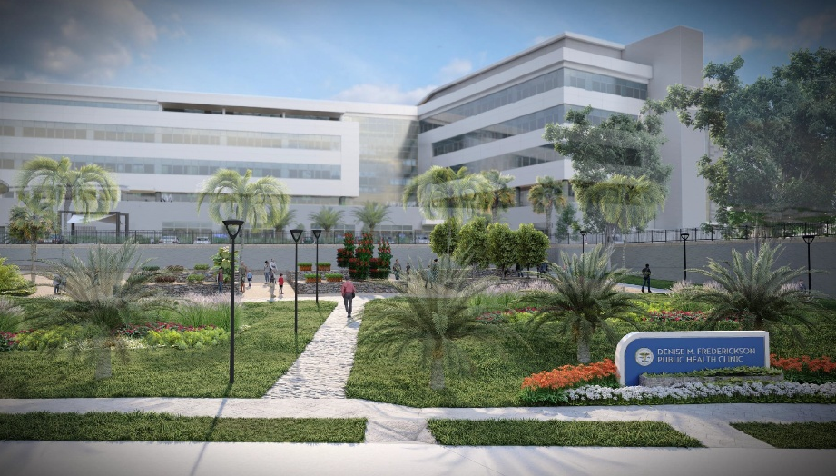
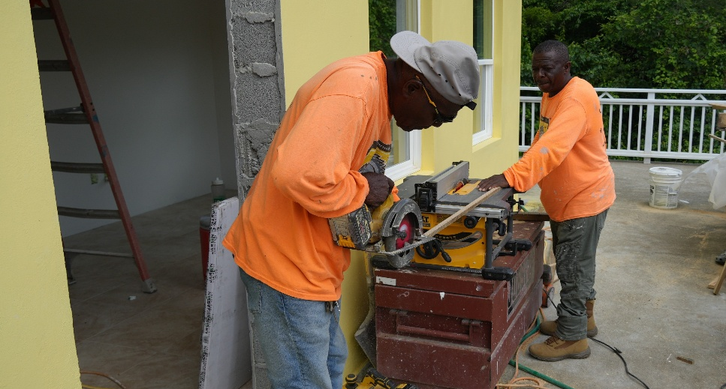
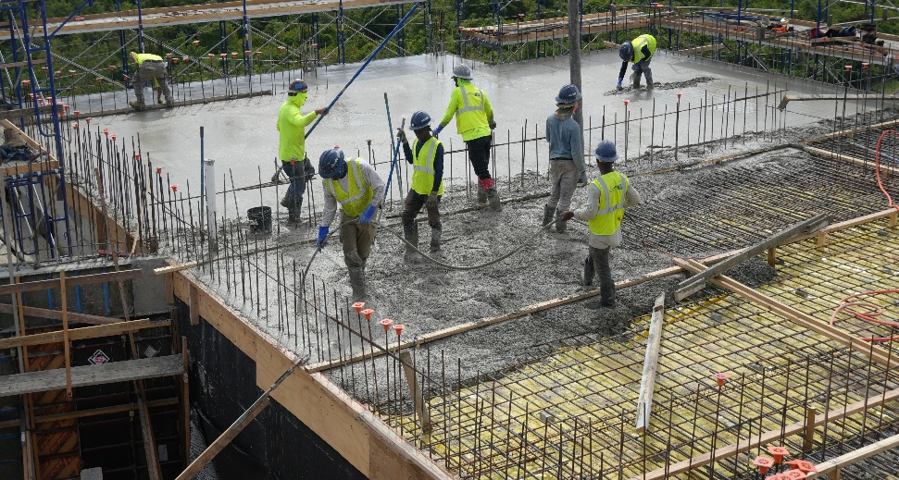
Objectives
Get the Funds
Spend the Funds
Spend the Funds Correctly
Secure the maximum amount of disaster recovery funds required for the Territory to rebuild resiliently.
Commence and conclude projects within the required timeframe to guarantee timely processing of Disaster Recovery funds.
Ensure projects executed meet all applicable programmatic and regulatory requirements and internal audits are conducted.

Slide 12
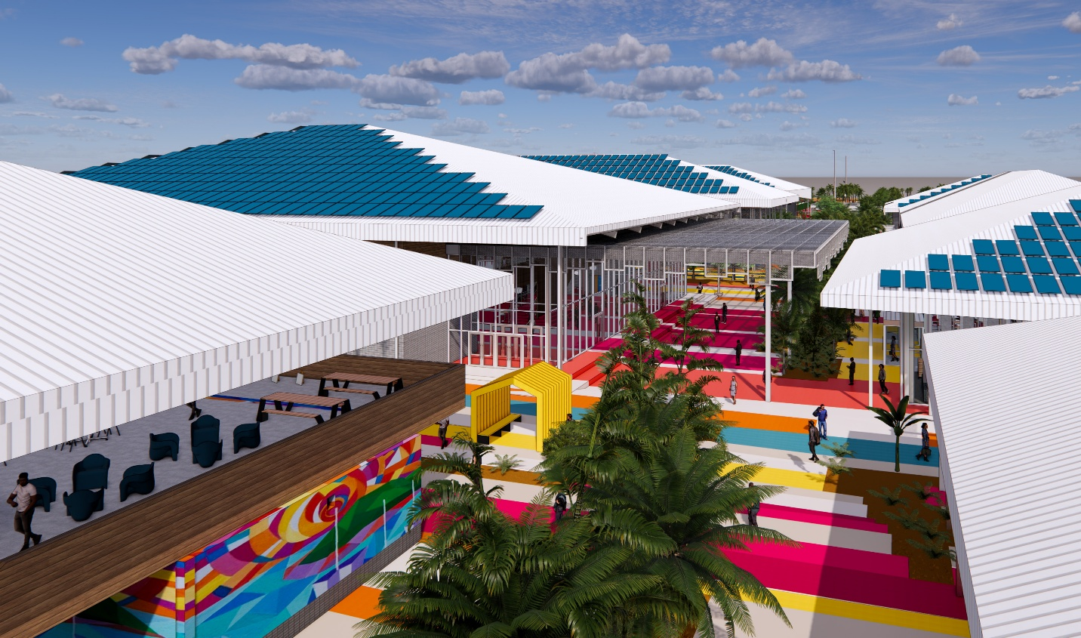
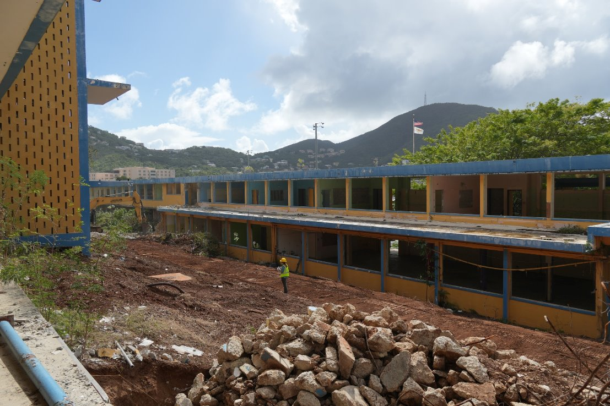
Fiscal 2027 Total Estimated Revenue |  |  | Key Revenue Drivers and Assumptions
FY: 27 Expenditures | $733,978,187.30 |  | Highlight 1: 5% Gross Receipt Taxes will be remitted from Disaster Recovery Projects in varying stages from design to construction
 |  |  | Highlight 2: Over 40 large scales projects will impact FY27 revenue
FY: 27 GRT Revenue | $36,698,909.36 |  | Highlight 3:Projects will generate other residual revenue in other taxes, licensing, permits, fees and housing
Central High School Rendering

Slide 13
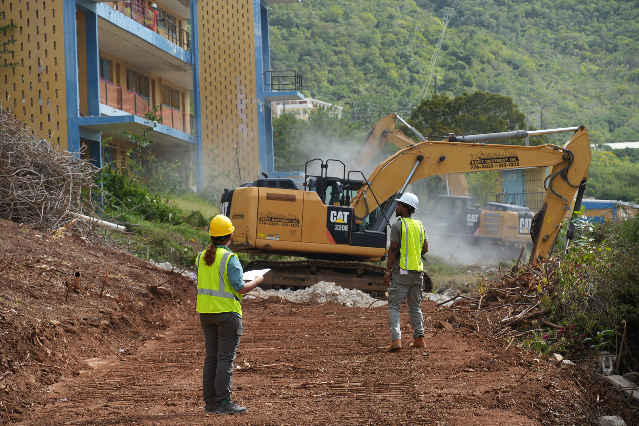
Key Projects
Health & Human Services
  Governor Juan F. Luis Hospital
  Schneider Regional Medical Center
  Donna M. Christensen Medical Complex
  Knud Hansen Building and Tower
  John S. Moorehead Complex
  Queen Louise Home for the Aged
  Herbert Grigg Home for the Aged
Infrastructure
  St. Croix North Central Horizontal Bundle
  St. Thomas East Horizontal
  Advanced Metering Infrastructure
  Richmond Power Generation
  Randolph Harley Power Generation
Schools
  Charlotte Amalie High School
  Bertha C Boschulte School
  Central High School
  St. Croix Educational Complex
  St. Thomas Educational Bundle
  St. Croix Educational Bundle
Other Highlights
  Envision Tomorrow Program
  STJ Multi-Sector Bundle
  Fire Station Bundle

Slide 14








Website
Website
Youtube
Youtube
@USVIODR
www.usviodr.com
@USVIODR
www.usviodr.com
Twitter X
Facebook
Twitter X
Facebook
@USVIODR
@ODRUSVI
@USVIODR
@ODRUSVI
THANK
YOU
Instagram
Instagram
LinkedIn
LinkedIn
@USVIODR
@USVIODR
@USVIODR
@USVIODR

Slide 15
2026 SPRING
REVENUE ESTIMATING CONFERENCE
MARCH 20, 2026

Slide 16
Office of the Lieutenant Governor
Division of Real Property Tax
Office of the Tax Collector
Presented by
Brent A. Leerdam
Tax Collector

Slide 17
Real Property Tax Total Estimated Revenue |  |  | Key Revenue Drivers and Assumptions
FY: 26 | $65,600,000.00 |  | Highlight 1: FY2026 Collections from Current Year Billing - $34.6M
 |  |  | Highlight 2: FY2026 Collections from Delinquent Year Invoices - $31M
FY: 27 | $65,600,000.00 |  | Highlight 3: FY2027 Collections from Current Year Billing - $34.6M
 |  |  | Highlight 4: FY2027 Collections from Delinquent Year Invoices - $31M
REVENUE BREAKDOWN
Revenue Category | Interval | Revenue Estimate | Fiscal Year
Current Year Billing | June 1, 2026 – August 30, 2026 | $34,600,000.00 | FY2026
Delinquent Year Invoices | Occurs All Year | $31,000,000.00 | FY2026
Current Year Billing | June 1, 2027 – August 30, 2027 | $34,600,000.00 | FY2027
Delinquent Year Invoices | Occurs All Year | $31,000,000.00 | FY2027

Slide 21
Objective
To develop a process flow that provides for fair and equitable enforcement in the collection of property taxes.
Tightened the regulations that govern real property tax final collection activities to remove fraud potential
Provided standardized rules for payment plans and reduced the deposit amount required to start a payment plan
Implemented standardized rules for the issuance of a Tax Clearance Certificate

Slide 22
Objective
Onboard a tax management system that both conforms to International Association of Assessing Officers (IAAO) standards and improves our audit response capabilities.
Improved our system database for real property tax management to replace outdated systems.
Implemented a system that uses standards required in 33 V.I.C. § 2404
Improved our ability to provide detailed reporting to audit entities

Slide 23
Objective
To improve the community impact of Final Collection Activities by advocating for the addition of in rem jurisdiction foreclosure, passed by the Legislature in Act 8466.
Provides for foreclosure on properties that have delinquent real property taxes, but not on the individual person or owner
Ensures that 75% of properties foreclosed upon will directly benefit first-time homebuyers, veterans, middle & low-to-moderate income, senior citizens or disabled persons.
Will greatly reduce ruined properties that may have been abandoned

Slide 24
Objective
To improve the collection record on both current year billing and on delinquent year invoices to reduce our total delinquencies.
Developed invoice tracking procedures to improve real property tax collection efforts
We plan to offer enhanced payment abilities within this fiscal year on our Citizen Access Portal https://propertytax.vi.gov
We will continue to encourage digital access for bill payments and look forward to a large percentage of clients that opt for electronic bill management

Slide 25
Analysis
Total Revenue Projections have increased steadily since FY2019
Largest increase in property tax revenue was in FY2024, after conducting a Final Collection Activity in FY2023
In Rem Jurisdiction Foreclosure Act 8466 will greatly enhance our ability to process Final Collection Activities, while providing a clear path to homeownership for those in need
Delinquency collections will continue to rise for the next few years, then will taper off as delinquencies are reduced

Slide 26
THANK
YOU

Slide 27

2026 SPRING
REVENUE ESTIMATING CONFERENCE
MARCH 20, 2026

Slide 28
Virgin Islands Department of Public Works
Presented by
Rueben Jennings
Assistant Commissioner

Slide 29
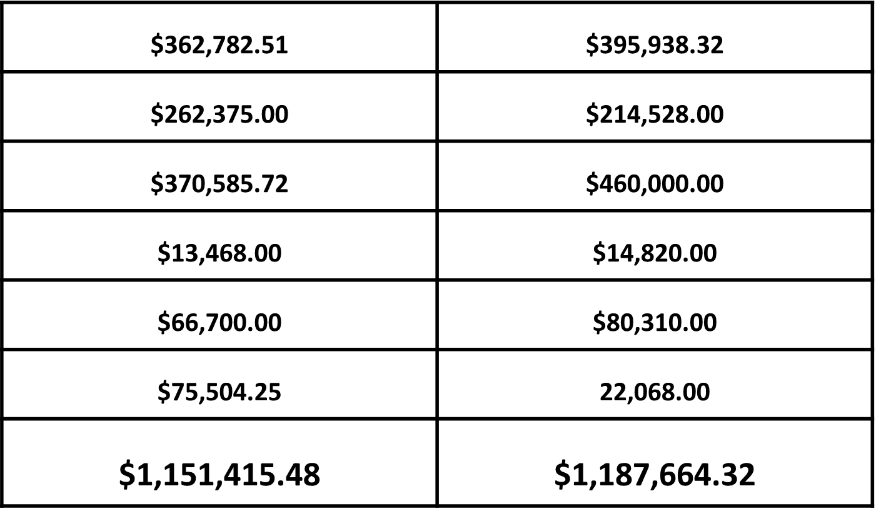
COLLECTIONS
FY2026
FY2027
VITRAN
CEMETERIES
PARKING LOTS
SPECIAL PERMITS & DRIVEWAY/EXCAVATION
ABANDONED VEHICLES
ADVERTISING
TOTAL

Slide 30
$362,782.51 | $395,938.32
$262,375.00 | $214,528.00
$370,585.72 | $460,000.00
$13,468.00 | $14,820.00
$66,700.00 | $80,310.00
$75,504.25 | 22,068.00
$1,151,415.48 | $1,187,664.32

Slide 31
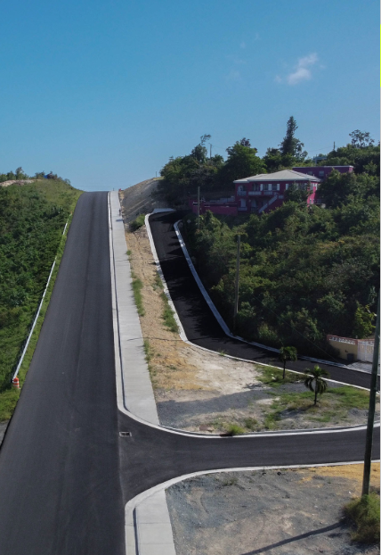
Federal Highway (FHWA) Funded (Annual Allocation)
$7
MILLION
  CLIFTON HILL
  RAPHUNE HILL
FY2026
$5.5
MILLION
FY2027

Slide 32
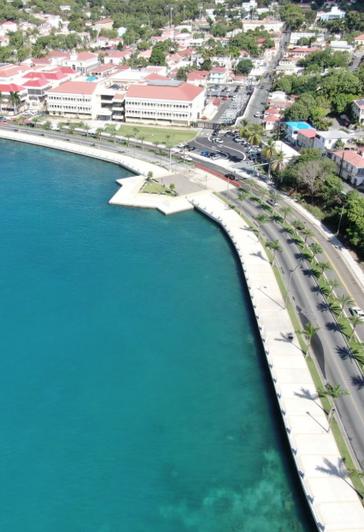
FEDERAL HIGHWAY (FHWA) Backed 2015 GARVEE BONDS
$14
  FREDERIKSTED ROADS
  ETHEL MCINTOSH MEM. DRIVE (MAHOGANY ROAD)
  SPRING GUT ROAD
MILLION
FY2026
$12
MILLION
FY2027

Slide 33
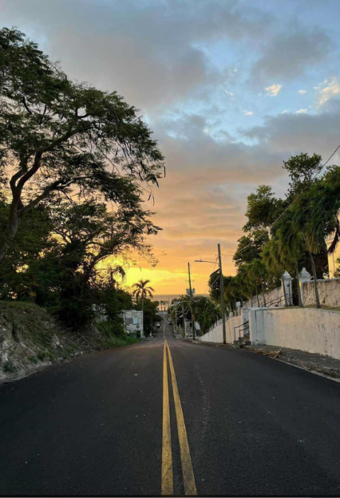
FEDERAL HIGHWAY (FHWA) Backed 2025 GARVEE BONDS
$8
ST. CROIX/ST. THOMAS FAST FERRY
VETERANS DRIVE PHASE 2A
SIDNEY LEE ROAD
EAST SCENIC ROAD
SOUTHSIDE ROAD
MILLION
FY2026
$26
MILLION
FY2027

Slide 34
LOCAL/OTHER FUNDS
$9.5
Emerald Hill
Bovoni Road
Armstrong Road
DeCastro Road
Rocky Road
Estate Contant-Tranquil Road
Coki Point
Washington School Road
Johnny Horn Trail
Cruz Bay Restrooms
Bolongo Road
Hospital Ground - Bethel Church Road
Meader Place Repairs – Retaining Wall
Estate Contant
STJ Centerline Guardrails
Leonardo Trotman Drive
Estate Thomas
Estate Peters Rest
Estate Diamond Ruby
Estate Barren Spot North Expansion
Estate Strawberry
Segments of Midland Road
Branded Street Signage
MILLION
FY2026
$3
MILLION
FY2027

Slide 35
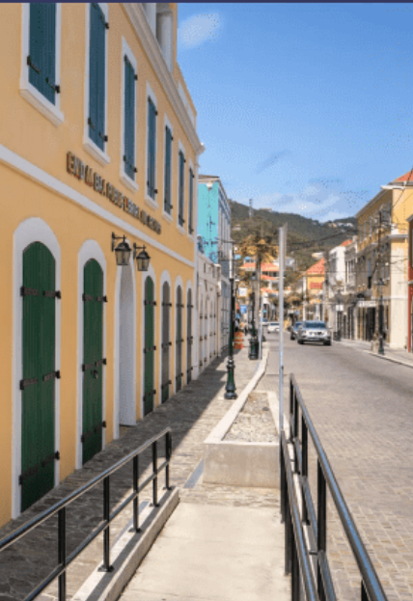
CAPITAL IMPROVEMENT PROJECTS
$24
Department of Human Services - Head Start Projects
Department of Human Services - Queen Louise Home for the Aged (Temporary)
Charles Seales Fire Station
Athalie McFarlane Petersen Library
Office of the Governor- New business, Old business & Legal Counsel
Department of Finance Renovation
VITEMA EOC Renovation
Randall “Doc” James Racetrack
Department of Public Works VITRAN Building
Department of Public Works Temporary Facility
Department of Public Works St. John Maintenance Building
Department of Planning & Natural Resources Office Building (Old WAPA Location)
MILLION
FY2026
$32
MILLION
FY2027

Slide 36




SUMMARY
2026
2027
TOTAL
GROSS RECEIPTS
TOTAL
GROSS RECEIPTS
$63.6
Million
$3.18
Million
$79.6
Million
$3.98
Million

Slide 37
Fiscal 2026 Total Estimated Revenue |  |  | Key Revenue Drivers and Assumptions
FY: 26 | $1,120,150.00 |  | Highlight 1: Additional Buses
 |  |  | Highlight 2: Abandoned Vehicle Fee STX collections
FY: 27 | $1,218,000.00 |  | Highlight 3: Extending operational parking lot hours
 |  |  | Highlight 4:
REVENUE BREAKDOWN
Revenue Category | Project Count (If Applicable) | Revenue Estimate 2026 | Revenue Estimate 2027
VITRAN | N/A | $360,000.00 | $425,000.00
CEMETERIES | N/A | $196,000.00 | $226,000.00
PARKING LOTS | N/A | $440,000.00 | $460,000.00
PERMITS | N/A | $100,750.00 | $87,000.00
ABANDONED VEHICLES | N/A | $23,400.00 | $20,000.00
Notes:
Fiscal 2026 Total Estimated Revenue
Key Revenue Drivers and Assumptions
1. Business Compliance and License Renewals
Driver:
• A significant portion of revenue comes from business license fees, which depend on business renewals and new business registrations.
• If businesses comply with renewal deadlines, licensing revenue remains stable or increases.
• Declining renewal rates or economic downturns could result in lower revenue collection.
Assumption:
• The projections assume consistent business activity and a stable number of license renewals over the next two years.
• If more businesses fail to renew due to economic conditions, revenue could decrease.
2. Regulatory Enforcement and Penalty Fees
Driver:
• Penalty fees for delinquencies and CPS, Weights and Measures and Enforcement actions contribute to total revenue, depending on the number of violations and enforcement actions.
• The DLCA has engaged stricter enforcement practices including night-time initiatives that will yield increased citations for noncompliance. For the foreseeable future we anticipate that these actions along with improved follow-through via our legal division will lead to increased collections.
Assumption:
• The projections assume penalty fees will remain relatively stable, with no significant decline in enforcement practices.
• If compliance improves, penalty revenues may decline. Conversely, more aggressive enforcement and tighter regulations should lead to higher collections.
3. Economic Growth and Business Expansion
Driver:
• Economic conditions impact new business formation, affecting license revenue.
• A growing economy leads to more business licenses, while a recession could reduce new applications.
Assumption:
• The projections assume moderate economic stability, with a gradual increase in new business licenses at a 3.1% growth rate.
• If economic conditions worsen, business growth could slow, affecting revenue collections.
4. Department Policy and Fee Adjustments
Driver:
• For more than a decade the DLCA has resisted a wholesale increase in license fees, opting instead for a more targeted approach. Increases in license fees for alcohol related businesses were implemented with no significant retraction of licenses. We anticipate that the time is ripe for some adjustment in license fees, penalties, and payment structures which can directly impact revenue.
• An increase in fees, could lead to revenues exceeding current estimates.
Assumption:
• The projections assume no major changes in licensing fees or penalties.
• Any policy changes (such as higher license fees or increased enforcement measures) could increase revenue beyond projections.
Conclusion
The revenue projections rely on stable business activity, consistent enforcement, economic stability, and unchanged policies. Any unexpected shifts in these factors could lead to higher or lower revenues than forecasted.

Slide 38
THANK
YOU

Slide 39


2026 SPRING
REVENUE ESTIMATING CONFERENCE
MARCH 20, 2026

Slide 40

BUREAU OF ECONOMIC RESEARCH
Dr. Haldane Davies
Director

Slide 41
USVI Fiscal 2026 Total Estimated Revenue |  |  | USVI Key Revenue Drivers and Assumptions
FY: 26 | $929,308,411 |  | Highlight 1: Revenues
 |  |  | Highlight 2: Visitor Arrivals
FY: 27 | $934,553,644 |  | Highlight 3: Workforce
 |  |  | Highlight 4: Gross Territorial Product (GTP)
The U.S. Virgin Islands’ total estimated GROSS revenues for FY 2026 ($929,308,411) and FY 2027 ($934,553,644) represent the combined collections from the territory’s major tax and revenue sources, including Real Property Taxes, Individual Income Taxes, Corporate Taxes, Excise Taxes, Gross Receipts Taxes, Stamp Taxes, Corporate Franchise Taxes, and Other Revenues. No Transfers-in or Transfers-out included. The Office of Management and Budget will report NET Revenue.
REVENUE BREAKDOWN
Revenue Category | Project Count (If Applicable) | Revenue Estimate | Fiscal Year
REPORTING | Twenty (20) or more reports. | $934,553,644 by FY 2027 | FY 2022 to 2025 (Actual) – FY 2026 to 2027 (Forecast)
Notes:
Fiscal 2026 Total Estimated Revenue
Key Revenue Drivers and Assumptions
1. Business Compliance and License Renewals
Driver:
• A significant portion of revenue comes from business license fees, which depend on business renewals and new business registrations.
• If businesses comply with renewal deadlines, licensing revenue remains stable or increases.
• Declining renewal rates or economic downturns could result in lower revenue collection.
Assumption:
• The projections assume consistent business activity and a stable number of license renewals over the next two years.
• If more businesses fail to renew due to economic conditions, revenue could decrease.
2. Regulatory Enforcement and Penalty Fees
Driver:
• Penalty fees for delinquencies and CPS, Weights and Measures and Enforcement actions contribute to total revenue, depending on the number of violations and enforcement actions.
• The DLCA has engaged stricter enforcement practices including night-time initiatives that will yield increased citations for noncompliance. For the foreseeable future we anticipate that these actions along with improved follow-through via our legal division will lead to increased collections.
Assumption:
• The projections assume penalty fees will remain relatively stable, with no significant decline in enforcement practices.
• If compliance improves, penalty revenues may decline. Conversely, more aggressive enforcement and tighter regulations should lead to higher collections.
3. Economic Growth and Business Expansion
Driver:
• Economic conditions impact new business formation, affecting license revenue.
• A growing economy leads to more business licenses, while a recession could reduce new applications.
Assumption:
• The projections assume moderate economic stability, with a gradual increase in new business licenses at a 3.1% growth rate.
• If economic conditions worsen, business growth could slow, affecting revenue collections.
4. Department Policy and Fee Adjustments
Driver:
• For more than a decade the DLCA has resisted a wholesale increase in license fees, opting instead for a more targeted approach. Increases in license fees for alcohol related businesses were implemented with no significant retraction of licenses. We anticipate that the time is ripe for some adjustment in license fees, penalties, and payment structures which can directly impact revenue.
• An increase in fees, could lead to revenues exceeding current estimates.
Assumption:
• The projections assume no major changes in licensing fees or penalties.
• Any policy changes (such as higher license fees or increased enforcement measures) could increase revenue beyond projections.
Conclusion
The revenue projections rely on stable business activity, consistent enforcement, economic stability, and unchanged policies. Any unexpected shifts in these factors could lead to higher or lower revenues than forecasted.

Slide 42

Objectives
Objective 1.
Objective 2.
Enhance the production and timeliness of core economic data. Objective (2026): Publish a reliable schedule for key indicators (e.g., CPI, unemployment, GDP) with at least 90% of reports released on or before target dates. Implement standardized quality checks and revision tracking to minimize errors and ensure consistent methodology.
Modernize data integration by 2026 by centralizing administrative datasets and establishing data cleaning and validation procedures. Aim for a unified economic database and complete documentation for major indicators.
Objective 3.
Objective 4.
Expand applied research to aid policy and planning. Objective (2026): Produce four key policy research products with clear findings and actionable recommendations for budgeting and planning.
Objective for 2026: Improve transparency by launching a public data portal for easier access to economic information. Aim for a 25% increase in report downloads and stakeholder satisfaction.
All data is subject to revision.

Slide 43

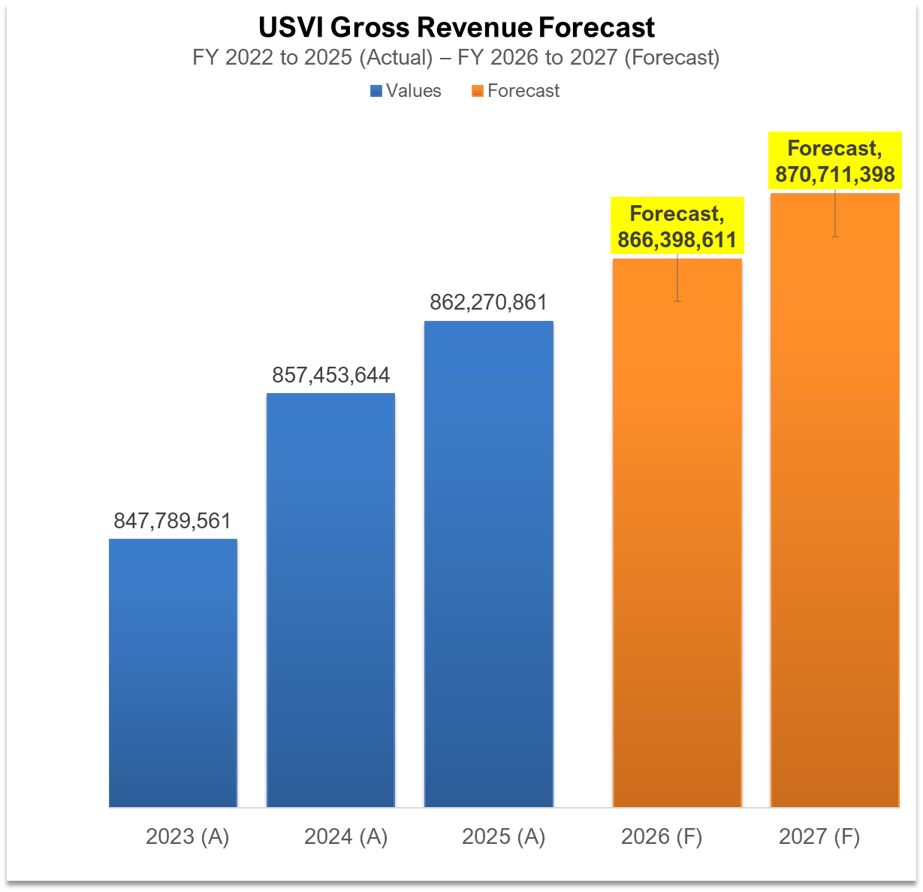
USVI Gross Revenue Forecast
FY 2023 to 2025 (Actual) – FY 2026 to 2027 (Forecast)
Note: This chart includes the Big Five revenue generators: Real Property, Individual Income, Corporate Taxes, Excise, and Gross Receipts, which together represent the primary sources of government revenue. No Transfers-in or Transfers-out included.
A consistent upward trend in the gross revenues of the US Virgin Islands (USVI) from fiscal year 2022 to fiscal year 2027. Revenues rise from approximately $849.2 million in 2022 to $862.3 million in 2025, with a slight dip in 2023 but overall stable growth. The forecast indicates revenues of $866.4 million in 2026 and $870.7 million in 2027, reflecting moderate fiscal strengthening. This pattern suggests a maturing revenue base supported by sustained economic activity and stable tax performance.
Note: Actuals compiled from DOF at https://dof.vi.gov/
All data is subject to revision.
Notes:
Key Observations
Steady Growth Trend
The total revenue has increased each year, showing a consistent upward trend.
The most significant increase occurred from FY 2021 to FY 2022, where revenues rose from $3.85 million to $4.51 million (a 17.4% increase).
This growth suggests an expansion in business licensing activities, possibly due to economic recovery, increased enforcement, or new business registrations.
Stabilization After FY 2022
The revenue increase slowed after FY 2022, with marginal growth in FY 2023 (0.5%) and FY 2024 (0.8%).
This indicates that the licensing market has matured, with fewer new businesses entering and renewals stabilizing.
Impact of External Factors
The growth in FY 2022 may have been influenced by post-pandemic economic recovery, as businesses resumed normal operations.
Regulatory changes or enforcement improvements may have contributed to better compliance and higher collections.
Projected Growth Moving Forward
The average annual growth rate across these years is 3.1%.
If this trend continues, revenues are expected to increase gradually rather than exhibit sharp growth spikes.

Slide 44

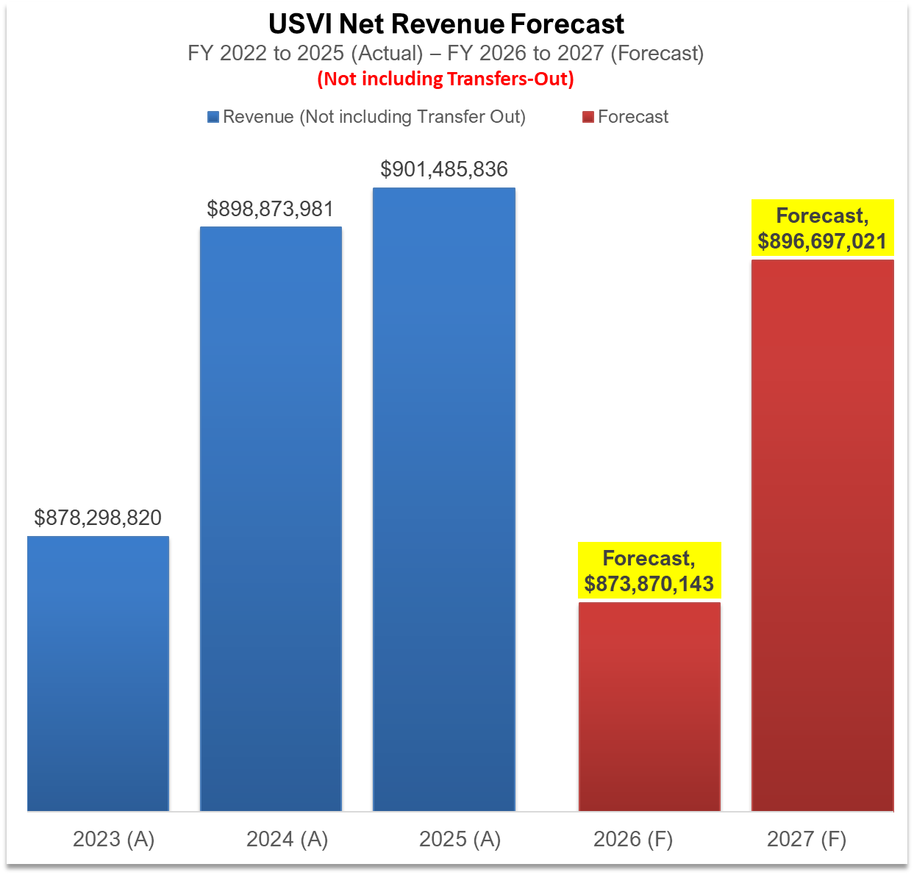
USVI Net Revenue Forecast
FY 2022 to 2025 (Actual) – FY 2026 to 2027 (Forecast)
Because the chart excludes Transfer-Out, it should be interpreted as a partial or adjusted revenue view rather than total revenue.
The net revenue trend for the US Virgin Islands (USVI) shows steady growth from $878.3 million in 2023 to a peak of $901.5 million in 2025. However, forecasts project a sharp drop to $873.9 million in 2026, followed by a partial rebound to $896.7 million in 2027. This suggests that the recent upward momentum may fluctuate due to anticipated economic pressures, leading to a temporary weakening of revenue before stabilizing at a lower growth rate.
Note: Actuals Provided by OMB
All data is subject to revision.

Slide 45

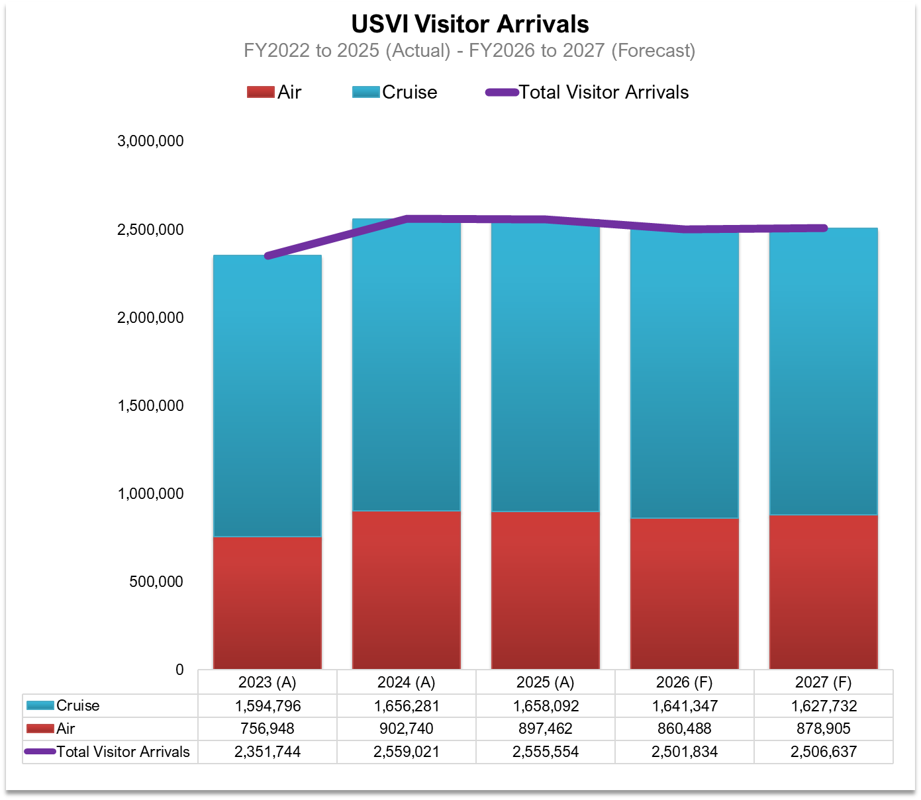
USVI Visitor Arrivals Forecast
FY2022 to 2025 (Actual) - FY2026 to 2027 (Forecast)
The US Virgin Islands (USVI) visitor arrivals fluctuated significantly from 2015 to 2027, largely due to cruise travel. After peaking at 2.7 million in 2015-2016, arrivals fell to 769,492 in 2021 due to disruptions. However, air arrivals rebounded, and total arrivals reached 2.35 million in 2023, projected to stabilize around 2.5 million by 2026-2027.
All data is subject to revision.
Notes:
Key Observations
Steady Growth Trend
The total revenue has increased each year, showing a consistent upward trend.
The most significant increase occurred from FY 2021 to FY 2022, where revenues rose from $3.85 million to $4.51 million (a 17.4% increase).
This growth suggests an expansion in business licensing activities, possibly due to economic recovery, increased enforcement, or new business registrations.
Stabilization After FY 2022
The revenue increase slowed after FY 2022, with marginal growth in FY 2023 (0.5%) and FY 2024 (0.8%).
This indicates that the licensing market has matured, with fewer new businesses entering and renewals stabilizing.
Impact of External Factors
The growth in FY 2022 may have been influenced by post-pandemic economic recovery, as businesses resumed normal operations.
Regulatory changes or enforcement improvements may have contributed to better compliance and higher collections.
Projected Growth Moving Forward
The average annual growth rate across these years is 3.1%.
If this trend continues, revenues are expected to increase gradually rather than exhibit sharp growth spikes.

Slide 46
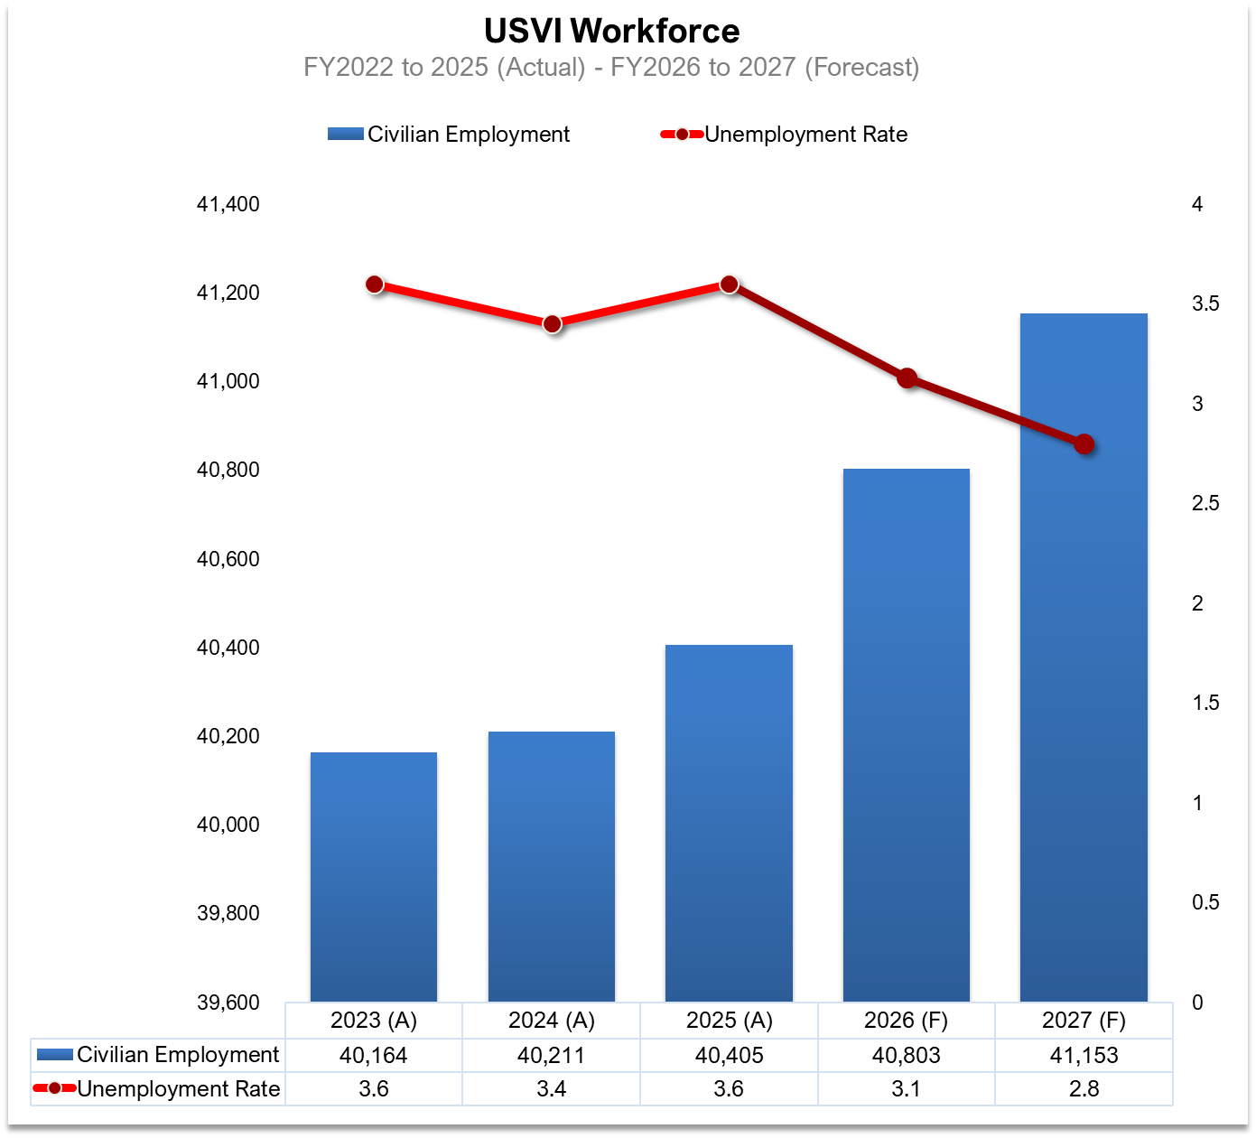
USVI Workforce Forecast
FY2022 to 2025 (Actual) - FY2026 to 2027 (Forecast)
The workforce has grown significantly from 2022 to 2023, increasing by about 600 to 700 workers. From 2023 to 2025, growth is expected to slow to an annual increase of 100 to 400 workers. By 2027, the workforce is projected to reach around 41,350, up from about 39,400 in 2022, marking an increase of about 2,000 workers. However, projections for 2026 and 2027 are uncertain, as much of the growth is linked to recovery efforts in the US Virgin Islands.
Note: Actuals compiled from DOL at https://www.vidol.gov/
All data is subject to revision.
Notes:
Key Observations
Steady Growth Trend
The total revenue has increased each year, showing a consistent upward trend.
The most significant increase occurred from FY 2021 to FY 2022, where revenues rose from $3.85 million to $4.51 million (a 17.4% increase).
This growth suggests an expansion in business licensing activities, possibly due to economic recovery, increased enforcement, or new business registrations.
Stabilization After FY 2022
The revenue increase slowed after FY 2022, with marginal growth in FY 2023 (0.5%) and FY 2024 (0.8%).
This indicates that the licensing market has matured, with fewer new businesses entering and renewals stabilizing.
Impact of External Factors
The growth in FY 2022 may have been influenced by post-pandemic economic recovery, as businesses resumed normal operations.
Regulatory changes or enforcement improvements may have contributed to better compliance and higher collections.
Projected Growth Moving Forward
The average annual growth rate across these years is 3.1%.
If this trend continues, revenues are expected to increase gradually rather than exhibit sharp growth spikes.

Slide 47
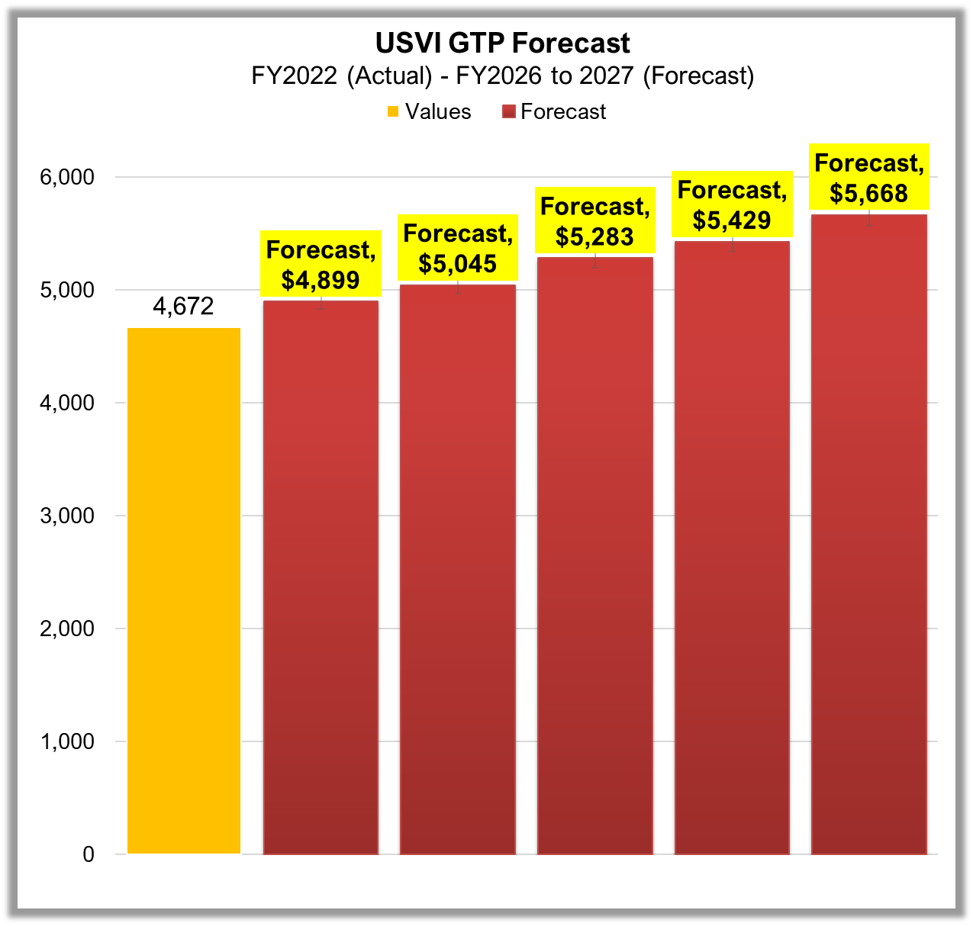
USVI Gross Territorial Product (GTP) Forecast
FY2022 (Actual) - FY2026 to 2027 (Forecast)
Please note that this forecast has been generated based on the trends indicated by the actual Gross Domestic Product (GDP or GTP) calculations conducted by the U.S. Bureau of Economic Analysis (BEA). It is important to clarify that this does not represent the official GDP calculation.
From 2022 to 2027, GDP is projected to grow from 4,672 to 5,668, representing a 21.3% increase with a compound annual growth rate (CAGR) of 3.9%. Yearly increases will vary, with the largest gain expected in 2027 at $239 million. GDP is anticipated to surpass 5,000 in 2024, with average annual growth of around $199 million and growth rates ranging from 2.8% to 4.9%.
2022 2023(F) 2024(F) 2025(F) 2026(F) 2027(F)
All data is subject to revision.
Notes:
Key Observations
Steady Growth Trend
The total revenue has increased each year, showing a consistent upward trend.
The most significant increase occurred from FY 2021 to FY 2022, where revenues rose from $3.85 million to $4.51 million (a 17.4% increase).
This growth suggests an expansion in business licensing activities, possibly due to economic recovery, increased enforcement, or new business registrations.
Stabilization After FY 2022
The revenue increase slowed after FY 2022, with marginal growth in FY 2023 (0.5%) and FY 2024 (0.8%).
This indicates that the licensing market has matured, with fewer new businesses entering and renewals stabilizing.
Impact of External Factors
The growth in FY 2022 may have been influenced by post-pandemic economic recovery, as businesses resumed normal operations.
Regulatory changes or enforcement improvements may have contributed to better compliance and higher collections.
Projected Growth Moving Forward
The average annual growth rate across these years is 3.1%.
If this trend continues, revenues are expected to increase gradually rather than exhibit sharp growth spikes.

Slide 48
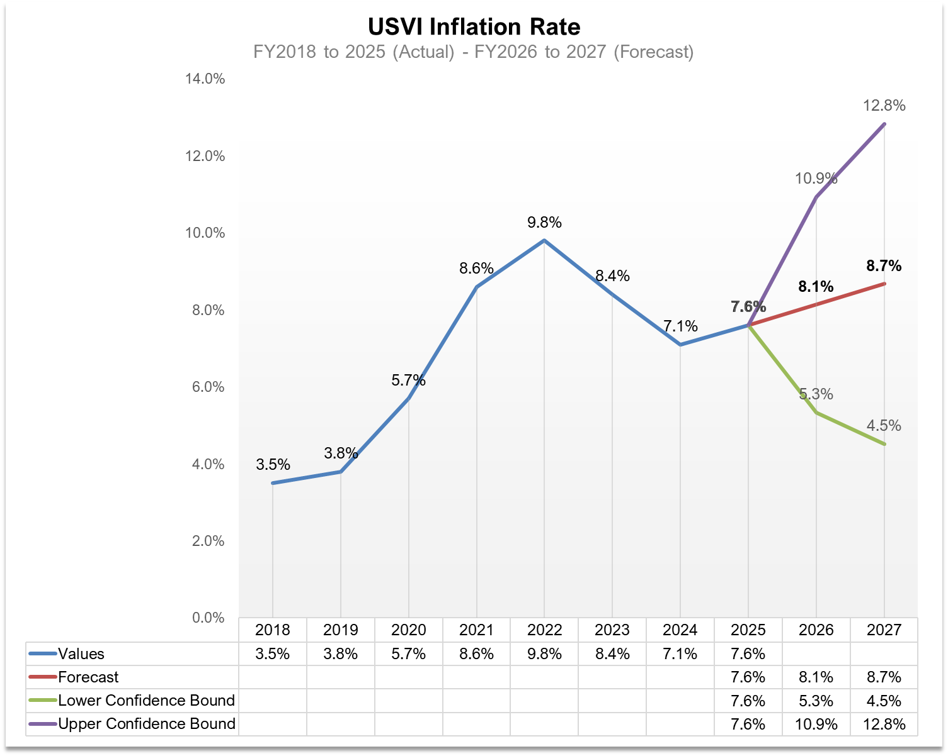
USVI Inflation Rate
FY2018 to 2025 (Actual) - FY2026 to 2027 (Forecast)
Inflation in the U.S. Virgin Islands has varied over time but is expected to rise moderately through 2026 and 2027, according to forecasts. Inflation will likely increase over the next two years, which may lead to higher costs across the territory.
Rising consumer prices.
Increased demand for goods compared to supply.
Higher import costs, typical for island economies.
Ongoing economic activity is pushing prices higher.
All data is subject to revision.
Notes:
Key Observations
Steady Growth Trend
The total revenue has increased each year, showing a consistent upward trend.
The most significant increase occurred from FY 2021 to FY 2022, where revenues rose from $3.85 million to $4.51 million (a 17.4% increase).
This growth suggests an expansion in business licensing activities, possibly due to economic recovery, increased enforcement, or new business registrations.
Stabilization After FY 2022
The revenue increase slowed after FY 2022, with marginal growth in FY 2023 (0.5%) and FY 2024 (0.8%).
This indicates that the licensing market has matured, with fewer new businesses entering and renewals stabilizing.
Impact of External Factors
The growth in FY 2022 may have been influenced by post-pandemic economic recovery, as businesses resumed normal operations.
Regulatory changes or enforcement improvements may have contributed to better compliance and higher collections.
Projected Growth Moving Forward
The average annual growth rate across these years is 3.1%.
If this trend continues, revenues are expected to increase gradually rather than exhibit sharp growth spikes.

Slide 49

THANK
YOU
All data is subject to revision.

Slide 50
2026 SPRING
REVENUE ESTIMATING CONFERENCE
MARCH 20, 2026

Slide 51
Department of Tourism
Presented by
Jennifer Matarangas-King
Commissioner

Slide 52
Agenda
Economy & Travel Outlook
Airlift
Accommodations
Cruise
STR
Revenue
Tax Revenue

Slide 53
Consumers continue to spend
Consumer spending: US
Growth
13.3%
Tax cuts and lower interest rates will help spending growth to gradually recover heading into 2026.
Volume
Price
Total
9.7%
6.5%
4.8%
5.6% _{5.3% 4.8%}
_{3.7%} 4.3%
_{4.3%} 4.4%
3.6% 3.5%
3.6%
3.1%
3.3% _{3.1%}
8.8%
1.9%
1.7%
1.7%
2.8%
3.4%
2.5%
2.6%
2.7%
2.2%
3.0%
2.6%
3.0%
2.6%
2.2%
0.2%
1.4%
-1.3%
-2.5%
-1.6%
-1.4%
2008 2009 2010 2011 2012 2013 2014 2015 2016 2017 2018 2019 2020 2021 2022 2023 2024 2025 2026
Note: Total is nominal consumer spending growth. Volume is real consumer spending growth. Source: BEA, Oxford Economics

Slide 54
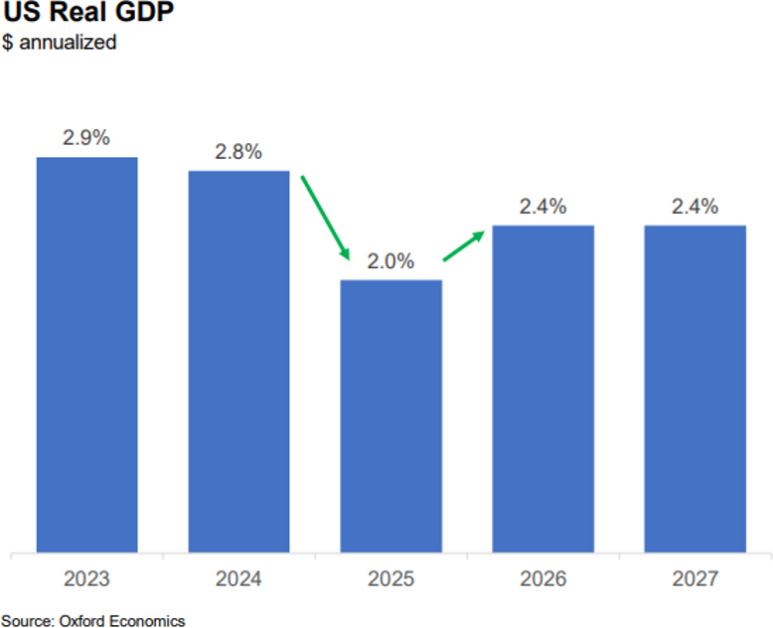
Economy Has Slowed But Should Pick Up in 2026

Slide 55
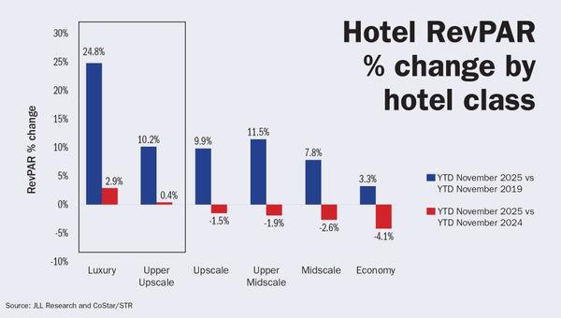
Hotel Growth Remains Bifurcated in 2025

Slide 56
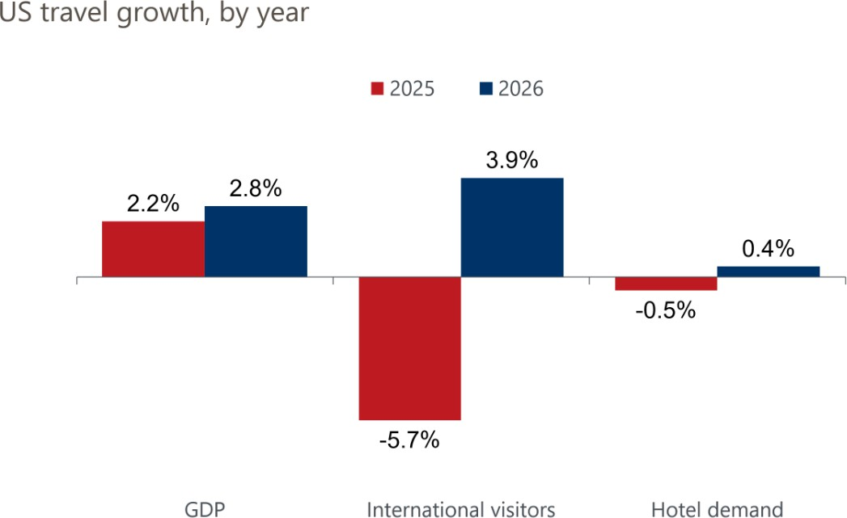
Travel Expected to Grow But Not Recover in 2026

Slide 57
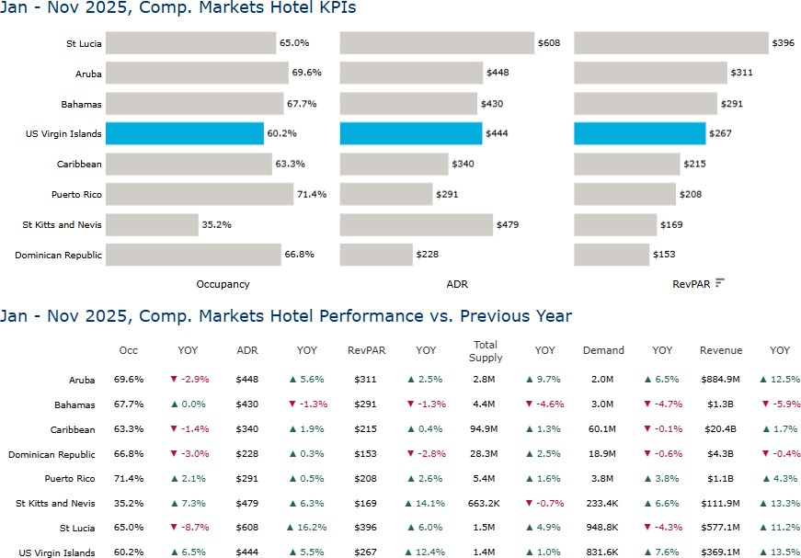

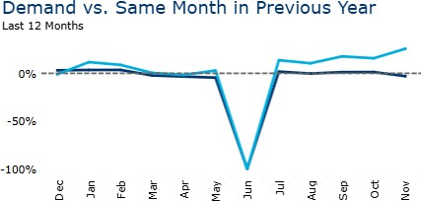
Through November, USVI Hotels Lead the Comp Set in Growth, Outpacing the Caribbean as a Whole in Demand Growth in 2025

Slide 58
Air Capacity & Visitors
Post-COVID, the U.S. Virgin Islands has seen a significant increase in airlift to the destination. There is a projected 16.5 percent rise in non-stop ﬂights from the U.S. in 2026 compared to 2025, a 11.8 percent increase when compared to 2024
STT seats are projected to increase by 21.6% in 2026. STX projects a -1.8% decrease compared to 2025. Compared to 2024, STT is up 13.2%, and STX is up 4.7%
Data represents Continental US Origin Markets
2026 = January - October

Slide 59
Air Arrivals – Continental U.S.
Destination | 2024 | 2025 | Change
St. Thomas/St. John | 743,912 | 725,263 | -2.5%
St. Croix | 185,746 | 182,995 | -1.5%
USVI | 929,658 | 908,258 | -2.3%
Destination | Feb 2025 YTD | Feb 2026 YTD | Change
St. Thomas/St. John | 135,882 | 150,421 | 10.7%
St. Croix | 36,115 | 37,881 | 4.9%
USVI | 171,997 | 188,302 | 9.5%
Source: Internal Dept of Tourism data

Slide 60
Regional Flights Breakdown
Regional Aircraft - STT | Weekly Flights | Seats
Winter 2024-25 | 169 | 2,419
Summer 2025 | 177 | 2,304
Winter 2025-26 | 110 | 1,216
Summer 2026 | 111 | 1,192
Regional Aircraft - STX | Weekly Flights | Seats
Winter 2024-25 | 113 | 2,173
Summer 2025 | 111 | 1,580
Winter 2025-26 | 58 | 527
Summer 2026 | 56 | 507
Source: Internal Dept of Tourism data
Seats decreased primarily due to Silver Airways' departure.
Contour Aviation added 115 flights.

Slide 61
Weekly Flights/Seat – Continental U.S.
Time Period | Weekly Flights Territory-Wide | Seats
Summer 2024 | 134 | 22,951
Winter 2024-25 | 153 | 25,659
Summer 2025 | 118 | 20,296
Winter 2025-26 | 169 | 28,328
Destination | Forecasted Weekly Flights | Seats
St. Thomas - Summer 2026 | 137 | 23,416
St. Croix - Summer 2026 | 20 | 3,280
Source: Internal Dept of Tourism data

Slide 62
Accommodations and Hotel Development
Hampton by Hilton - St. Thomas​
126 rooms (Opened August 2025)​
The Saint - St. John​​
6 rooms (Opened February 2025)​
Hibiscus Hotel - St. Croix​
100 rooms (2025-2027)​
The Botany- St. Thomas
23 villas (2026)​
Sugar Bay - St. Thomas​
300 rooms (TBD) Timing TBD​
TOTAL New Rooms in STX: 178
TOTAL New Rooms in STT/STJ: 455​
Type | St. Croix | St. Thomas / St. John | Estimated Total Accommodations
Hotel/Resort Rooms | 1,000 | 2,286 | 3,286
Villa | 300 | 600 | 900
Charter Yachts |  | 250+ | 250+
Timeshares |  | 1,022 | 1,022
Airbnb/VRBO, etc. | 1,190 | 4,579 | 5,769

Slide 63
Sharing Economy
Time Period | Revenue January | Revenue Last 12 Months
2024 | $26,477,187 | $204,379,775
2025 | $31,267,736 | $243,707,206
2026 | $35,214,371 | $256,116,314
Time Period | Supply Nights / Demand Nights – January | Supply Nights / Demand Nights – Last 12 Months
2024 | 106,191/70,490 | 922,495/ 535,064
2025 | 110,691/75,063 | 1,042,294/610,507
2026 | 114,152/80,385 | 1,040,718/606,428
Source: AirDNA Trend Report Jan 2026

Slide 64
Cruise STT and STX 2026
Cruise ship passenger volumes for 2026 are expected to exceed 2025 levels for the USVI.
Cruise passengers increased by 94,000 territory-wide in 2025.
Projected passengers for 2026 are 1.9 million:
  WICO: 1,100,000 Passengers
  Crown Bay: 585,000 Passengers
  AAMF: 220,000 Passengers
Preliminary projected passengers for 2027 are 1.9 million
Source: BER, VIPA, WICO

Slide 65
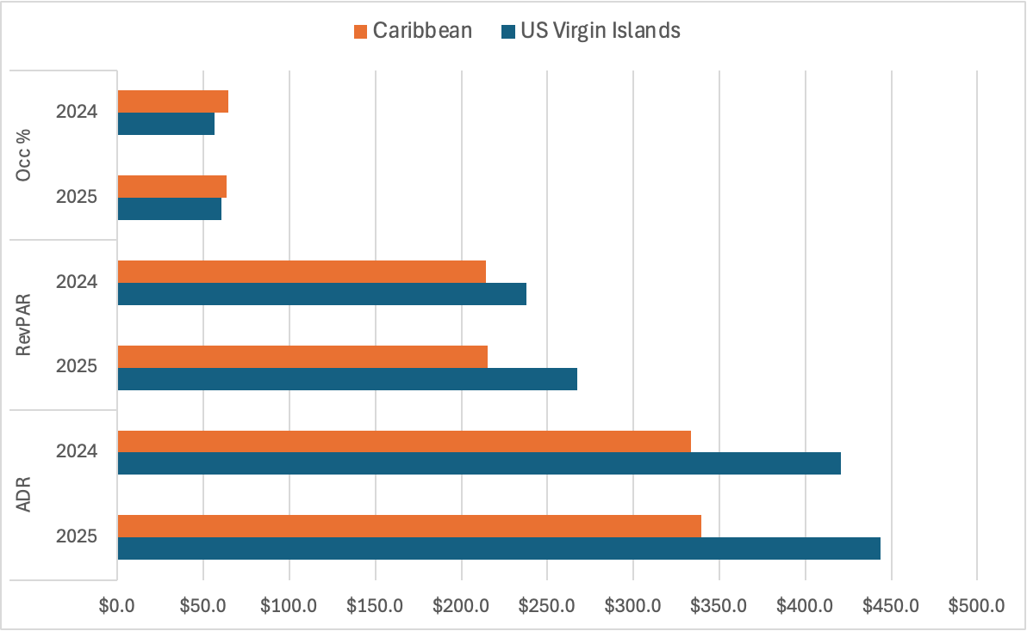
STR Data YTD 2025 vs. 2024
ADR is $666 (2025)
Source: STR data March 2025

Slide 66
Hotel Tax Revenue Collected YTD & FY
Time Period | Revenue Collected
JANUARY YTD FY 2024 | $11,427,603
JANUARY YTD FY 2025 | $11,106,733
JANUARY YTD FY 2026 | $12,998,475
Time Period | Revenue Collected
FISCAL YEAR 2024 | $51,201,594
FISCAL YEAR 2025 | $52,924,503
FISCAL YEAR 2026 – Projected | $54,000,000
Source: USVI Bureau of Internal Revenue

Slide 67
Tax Revenue Estimate Snapshot
Industry Projected Growth:
Projected growth rate of 0.4% for FY 2026
Projected growth rate of 2% for FY 2027
Projected Collections:
2026 Hotel Room Tax Collection: $53,982,993
2027 Hotel Room Tax Collection: $55,062,653

Slide 68
THANK
YOU

Slide 69
2026 SPRING
REVENUE ESTIMATING CONFERENCE
MARCH 20, 2026

Slide 70
VIRGIN ISLANDS ECONOMIC DEVELOPMENT AUTHORITY
Presented by Wayne L. Biggs, Jr.
Chief Executive Officer

Slide 71

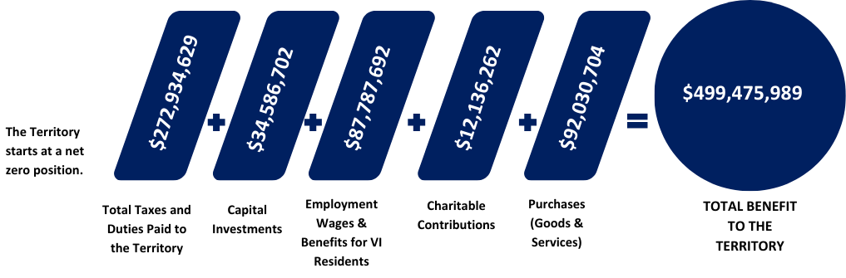
EDC Program Economic Impact
Fiscal Year 2023
(As of September 30, 2025)
Fact: Tax incentives are intended to spur economic growth that would not have otherwise occurred.

Slide 72
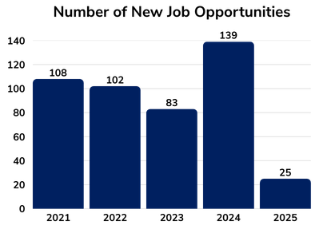
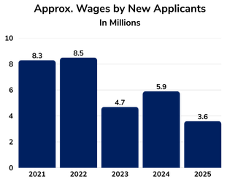
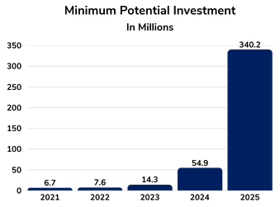
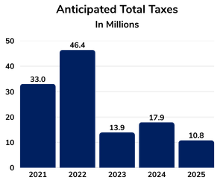
Historical New Applicant Statistics

Slide 73
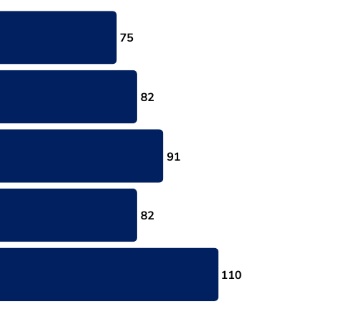
Active VIEDC Beneficiaries
2021
2022
2023
2024
2025
As of September 30, 2025

Slide 74

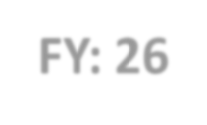
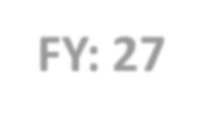
Fiscal 2026 Total Estimated Revenue |  |  | Key Revenue Drivers and Assumptions
FY: 26 | $5M |  | Highlight 1: New Virgin Islands Economic Development Commission (VIEDC) Beneficiaries – 4 per year
 |  |  | Highlight 2: Taxes from VIEDC Beneficiary Operations’ Income
FY: 27 | $10M |  | Highlight 3: Taxes on VIEDC Beneficiary Principals’ Global Income
REVENUE BREAKDOWN
Revenue Category | Revenue Estimate | Fiscal Year
Direct Taxes | Year 1: $5M (Based on 4 applicants) | 2026
Direct Taxes | Year 2: $10M (Based on 8 applicants) | 2027

Slide 75

FY 2026-2027
EDA Generated Revenues
Year 2:
FY 2027
This is based on the assumption that four (4) new
$10M
($5M-Yr. 1 + $5M-Yr. 2)
applicants will generate an estimated $2.5M each in direct taxes and taxes on other global income per year for a total of $5M.
Given this pattern, we estimate $10M will be generated in Year 2 from the onboarding of four (4) additional applicants plus the existing four (4) beneficiaries from Year 1.
Year 1:
FY 2026
$5M

Slide 76
Objective
Attracting business investment to the Territory to support the tax base and job creation.

Slide 77






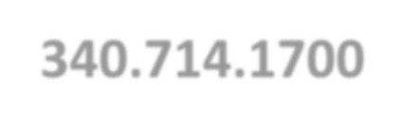


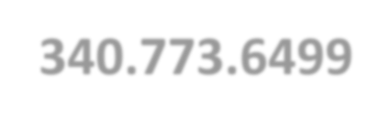
Contact Us
www.usvieda.org
STT: 340.714.1700
STX: 340.773.6499
info@usvieda.org

Slide 78
VIRGIN ISLANDS HOUSING FINANCE AUTHORITY
Executive Director
Eugene Jones, Jr.
2026 SPRING
REVENUE ESTIMATING CONFERENCE
MARCH 20, 2026

Slide 79
Virgin Islands Housing Finance Authority
Monifa Evans
Community Development Block Grant Disaster Recovery
Director of Finance

Slide 80
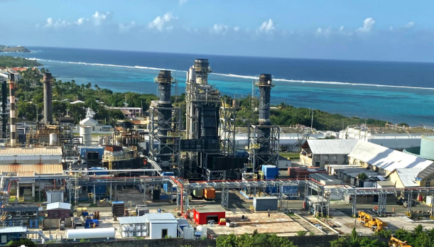
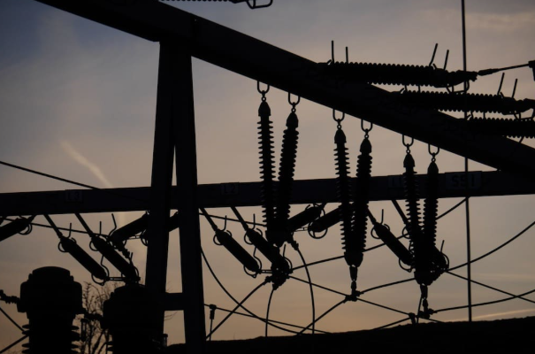
MITIGATION
$774.2M
ELECTRICAL GRID
$67.7M
Pictures courtesy of WTJX, VI Consortium and St. Thomas Source

Slide 81
Fiscal 2026 Total Estimated Revenue |  |  | Key Revenue Drivers and Assumptions
FY: 26 | $30,992,117 Mitigation/Electrical Grid |  | Highlight 1: Availability of funds for all the projects
 |  |  | Highlight 2: Maintain and follow the established project schedules and timelines
FY: 27 | $58,389,050 Mitigation/Electrical Grid |  | Highlight 3: Project oversight and coordination between all entities
REVENUE BREAKDOWN
Revenue Category | Project Count | Revenue Estimate | Fiscal Year
MIT - Housing | 4 | $10,471,679 | FY 26
MIT/EG- Infrastructure | 3 | $15,145,148 | FY 26
MIT - Economic Revitalization & Resilience/Public Facilities | 7 | $5,375,290 | FY 26
MIT – Housing | 5 | $19,844,194 | FY 27
MIT/EG – Infrastructure | 5 | $26,427,629 | FY 27
MIT – Economic Revitalization & Resilience/Public Facilities | 12 | $12,117,227 | FY 27
Notes:
Fiscal 2026 Total Estimated Revenue
Key Revenue Drivers and Assumptions
1. Business Compliance and License Renewals
Driver:
• A significant portion of revenue comes from business license fees, which depend on business renewals and new business registrations.
• If businesses comply with renewal deadlines, licensing revenue remains stable or increases.
• Declining renewal rates or economic downturns could result in lower revenue collection.
Assumption:
• The projections assume consistent business activity and a stable number of license renewals over the next two years.
• If more businesses fail to renew due to economic conditions, revenue could decrease.
2. Regulatory Enforcement and Penalty Fees
Driver:
• Penalty fees for delinquencies and CPS, Weights and Measures and Enforcement actions contribute to total revenue, depending on the number of violations and enforcement actions.
• The DLCA has engaged stricter enforcement practices including night-time initiatives that will yield increased citations for noncompliance. For the foreseeable future we anticipate that these actions along with improved follow-through via our legal division will lead to increased collections.
Assumption:
• The projections assume penalty fees will remain relatively stable, with no significant decline in enforcement practices.
• If compliance improves, penalty revenues may decline. Conversely, more aggressive enforcement and tighter regulations should lead to higher collections.
3. Economic Growth and Business Expansion
Driver:
• Economic conditions impact new business formation, affecting license revenue.
• A growing economy leads to more business licenses, while a recession could reduce new applications.
Assumption:
• The projections assume moderate economic stability, with a gradual increase in new business licenses at a 3.1% growth rate.
• If economic conditions worsen, business growth could slow, affecting revenue collections.
4. Department Policy and Fee Adjustments
Driver:
• For more than a decade the DLCA has resisted a wholesale increase in license fees, opting instead for a more targeted approach. Increases in license fees for alcohol related businesses were implemented with no significant retraction of licenses. We anticipate that the time is ripe for some adjustment in license fees, penalties, and payment structures which can directly impact revenue.
• An increase in fees, could lead to revenues exceeding current estimates.
Assumption:
• The projections assume no major changes in licensing fees or penalties.
• Any policy changes (such as higher license fees or increased enforcement measures) could increase revenue beyond projections.
Conclusion
The revenue projections rely on stable business activity, consistent enforcement, economic stability, and unchanged policies. Any unexpected shifts in these factors could lead to higher or lower revenues than forecasted.

Slide 82
Community Development Block Grant Projects
Housing Projects
Lovenlund Phase I
Bellevue Village & Calabash Boom
Residences at 340 North
Wild Pineapple – Fortuna
Mount Pleasant
Main Street Homes
Infrastructure Projects
DPW Veterans Drive Road Extension
WAPA Distribution Automated Devices
WAPA Transfer Replacement Project
Energy Office - Energy Vulnerability
Economic Revitalization and Resilience Projects
Royale Systems
St. Croix Women’s Coalition
Sejah Farms
VI Aqua Farms
Our Town Frederiksted
Notes:
Key Observations
Steady Growth Trend
The total revenue has increased each year, showing a consistent upward trend.
The most significant increase occurred from FY 2021 to FY 2022, where revenues rose from $3.85 million to $4.51 million (a 17.4% increase).
This growth suggests an expansion in business licensing activities, possibly due to economic recovery, increased enforcement, or new business registrations.
Stabilization After FY 2022
The revenue increase slowed after FY 2022, with marginal growth in FY 2023 (0.5%) and FY 2024 (0.8%).
This indicates that the licensing market has matured, with fewer new businesses entering and renewals stabilizing.
Impact of External Factors
The growth in FY 2022 may have been influenced by post-pandemic economic recovery, as businesses resumed normal operations.
Regulatory changes or enforcement improvements may have contributed to better compliance and higher collections.
Projected Growth Moving Forward
The average annual growth rate across these years is 3.1%.
If this trend continues, revenues are expected to increase gradually rather than exhibit sharp growth spikes.

Slide 83

Objectives
Partner with housing developers to construct new low-to-moderate income homes across the Territory, expand housing opportunities while promoting economic growth and supporting long-term revenue.
Advance Infrastructure, Economic Resilience and Revitalization projects Territory-wide by obligating 100% and expending 50% of the CDBG-MIT funds and obligating 100% and expending 45% of Electrical Grid funds.
Partner with stakeholders to continuously track projects from start to completion while ensuring that costs are accurately billed and revenues are received timely according to our grant requirements.

Slide 84
THANK
YOU

Slide 85
2026 SPRING
REVENUE ESTIMATING CONFERENCE
MARCH 20, 2026

Slide 86
VI Waste Management Authority
Presented by
Hannibal “Mike” Ware
Executive Director

Slide 87
Fiscal 2026 & 2027 Total Estimated Revenue
FY: 26 | $2,462,047.00 Gross Receipts
FY: 27 | $5,611,667.63 Gross Receipts
Key Revenue Drivers on Following Page
Notes:
Fiscal 2026 Total Estimated Revenue
Key Revenue Drivers and Assumptions
1. Business Compliance and License Renewals
Driver:
• A significant portion of revenue comes from business license fees, which depend on business renewals and new business registrations.
• If businesses comply with renewal deadlines, licensing revenue remains stable or increases.
• Declining renewal rates or economic downturns could result in lower revenue collection.
Assumption:
• The projections assume consistent business activity and a stable number of license renewals over the next two years.
• If more businesses fail to renew due to economic conditions, revenue could decrease.
2. Regulatory Enforcement and Penalty Fees
Driver:
• Penalty fees for delinquencies and CPS, Weights and Measures and Enforcement actions contribute to total revenue, depending on the number of violations and enforcement actions.
• The DLCA has engaged stricter enforcement practices including night-time initiatives that will yield increased citations for noncompliance. For the foreseeable future we anticipate that these actions along with improved follow-through via our legal division will lead to increased collections.
Assumption:
• The projections assume penalty fees will remain relatively stable, with no significant decline in enforcement practices.
• If compliance improves, penalty revenues may decline. Conversely, more aggressive enforcement and tighter regulations should lead to higher collections.
3. Economic Growth and Business Expansion
Driver:
• Economic conditions impact new business formation, affecting license revenue.
• A growing economy leads to more business licenses, while a recession could reduce new applications.
Assumption:
• The projections assume moderate economic stability, with a gradual increase in new business licenses at a 3.1% growth rate.
• If economic conditions worsen, business growth could slow, affecting revenue collections.
4. Department Policy and Fee Adjustments
Driver:
• For more than a decade the DLCA has resisted a wholesale increase in license fees, opting instead for a more targeted approach. Increases in license fees for alcohol related businesses were implemented with no significant retraction of licenses. We anticipate that the time is ripe for some adjustment in license fees, penalties, and payment structures which can directly impact revenue.
• An increase in fees, could lead to revenues exceeding current estimates.
Assumption:
• The projections assume no major changes in licensing fees or penalties.
• Any policy changes (such as higher license fees or increased enforcement measures) could increase revenue beyond projections.
Conclusion
The revenue projections rely on stable business activity, consistent enforcement, economic stability, and unchanged policies. Any unexpected shifts in these factors could lead to higher or lower revenues than forecasted.

Slide 88
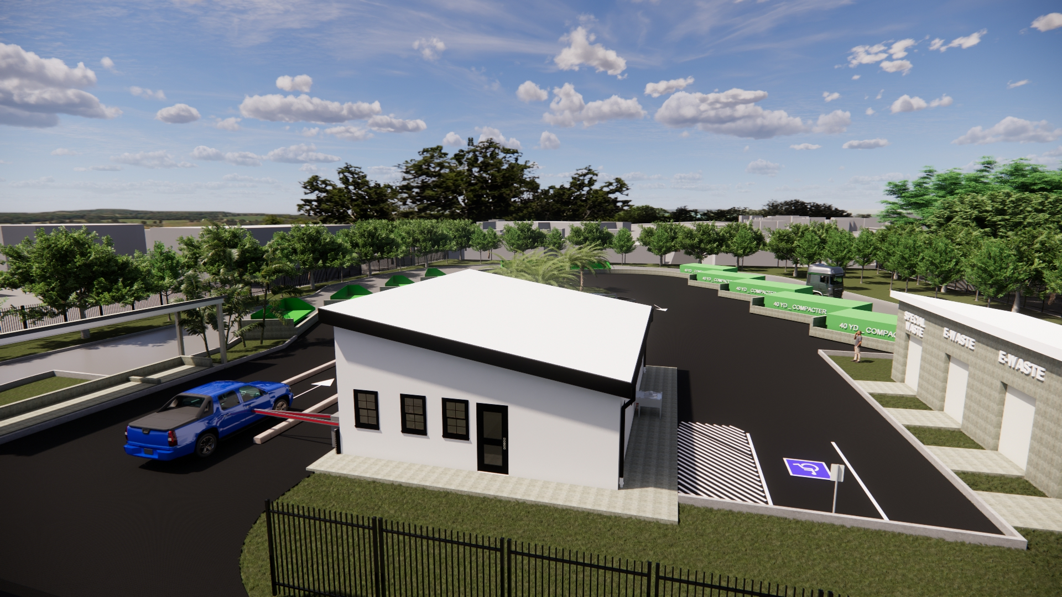
Highlight 1: VIWMA has initiated the CDBG‑DR–funded Convenience Center Projects, which will modernize and replace existing garbage bin sites. The total project budget is $18,046,064.45, and construction is expected to be completed over a two‑year period.
Notes:
Fiscal 2026 Total Estimated Revenue
Key Revenue Drivers and Assumptions
1. Business Compliance and License Renewals
Driver:
• A significant portion of revenue comes from business license fees, which depend on business renewals and new business registrations.
• If businesses comply with renewal deadlines, licensing revenue remains stable or increases.
• Declining renewal rates or economic downturns could result in lower revenue collection.
Assumption:
• The projections assume consistent business activity and a stable number of license renewals over the next two years.
• If more businesses fail to renew due to economic conditions, revenue could decrease.
2. Regulatory Enforcement and Penalty Fees
Driver:
• Penalty fees for delinquencies and CPS, Weights and Measures and Enforcement actions contribute to total revenue, depending on the number of violations and enforcement actions.
• The DLCA has engaged stricter enforcement practices including night-time initiatives that will yield increased citations for noncompliance. For the foreseeable future we anticipate that these actions along with improved follow-through via our legal division will lead to increased collections.
Assumption:
• The projections assume penalty fees will remain relatively stable, with no significant decline in enforcement practices.
• If compliance improves, penalty revenues may decline. Conversely, more aggressive enforcement and tighter regulations should lead to higher collections.
3. Economic Growth and Business Expansion
Driver:
• Economic conditions impact new business formation, affecting license revenue.
• A growing economy leads to more business licenses, while a recession could reduce new applications.
Assumption:
• The projections assume moderate economic stability, with a gradual increase in new business licenses at a 3.1% growth rate.
• If economic conditions worsen, business growth could slow, affecting revenue collections.
4. Department Policy and Fee Adjustments
Driver:
• For more than a decade the DLCA has resisted a wholesale increase in license fees, opting instead for a more targeted approach. Increases in license fees for alcohol related businesses were implemented with no significant retraction of licenses. We anticipate that the time is ripe for some adjustment in license fees, penalties, and payment structures which can directly impact revenue.
• An increase in fees, could lead to revenues exceeding current estimates.
Assumption:
• The projections assume no major changes in licensing fees or penalties.
• Any policy changes (such as higher license fees or increased enforcement measures) could increase revenue beyond projections.
Conclusion
The revenue projections rely on stable business activity, consistent enforcement, economic stability, and unchanged policies. Any unexpected shifts in these factors could lead to higher or lower revenues than forecasted.

Slide 89
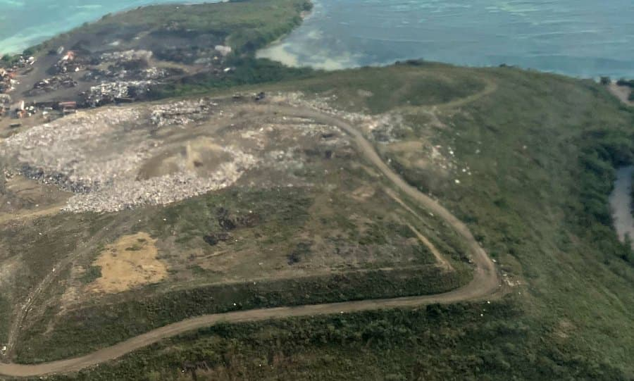
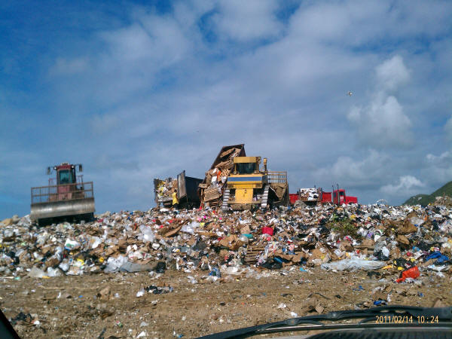
Highlight 2: VIHFA is finalizing the Notice to Proceed for the Authority under the $46 million CDBG‑DR grant. This funding will support the closure of Anguilla Landfill Sites 1–6 and the development and commissioning of Sites 7 and 8.
Notes:
Fiscal 2026 Total Estimated Revenue
Key Revenue Drivers and Assumptions
1. Business Compliance and License Renewals
Driver:
• A significant portion of revenue comes from business license fees, which depend on business renewals and new business registrations.
• If businesses comply with renewal deadlines, licensing revenue remains stable or increases.
• Declining renewal rates or economic downturns could result in lower revenue collection.
Assumption:
• The projections assume consistent business activity and a stable number of license renewals over the next two years.
• If more businesses fail to renew due to economic conditions, revenue could decrease.
2. Regulatory Enforcement and Penalty Fees
Driver:
• Penalty fees for delinquencies and CPS, Weights and Measures and Enforcement actions contribute to total revenue, depending on the number of violations and enforcement actions.
• The DLCA has engaged stricter enforcement practices including night-time initiatives that will yield increased citations for noncompliance. For the foreseeable future we anticipate that these actions along with improved follow-through via our legal division will lead to increased collections.
Assumption:
• The projections assume penalty fees will remain relatively stable, with no significant decline in enforcement practices.
• If compliance improves, penalty revenues may decline. Conversely, more aggressive enforcement and tighter regulations should lead to higher collections.
3. Economic Growth and Business Expansion
Driver:
• Economic conditions impact new business formation, affecting license revenue.
• A growing economy leads to more business licenses, while a recession could reduce new applications.
Assumption:
• The projections assume moderate economic stability, with a gradual increase in new business licenses at a 3.1% growth rate.
• If economic conditions worsen, business growth could slow, affecting revenue collections.
4. Department Policy and Fee Adjustments
Driver:
• For more than a decade the DLCA has resisted a wholesale increase in license fees, opting instead for a more targeted approach. Increases in license fees for alcohol related businesses were implemented with no significant retraction of licenses. We anticipate that the time is ripe for some adjustment in license fees, penalties, and payment structures which can directly impact revenue.
• An increase in fees, could lead to revenues exceeding current estimates.
Assumption:
• The projections assume no major changes in licensing fees or penalties.
• Any policy changes (such as higher license fees or increased enforcement measures) could increase revenue beyond projections.
Conclusion
The revenue projections rely on stable business activity, consistent enforcement, economic stability, and unchanged policies. Any unexpected shifts in these factors could lead to higher or lower revenues than forecasted.

Slide 90
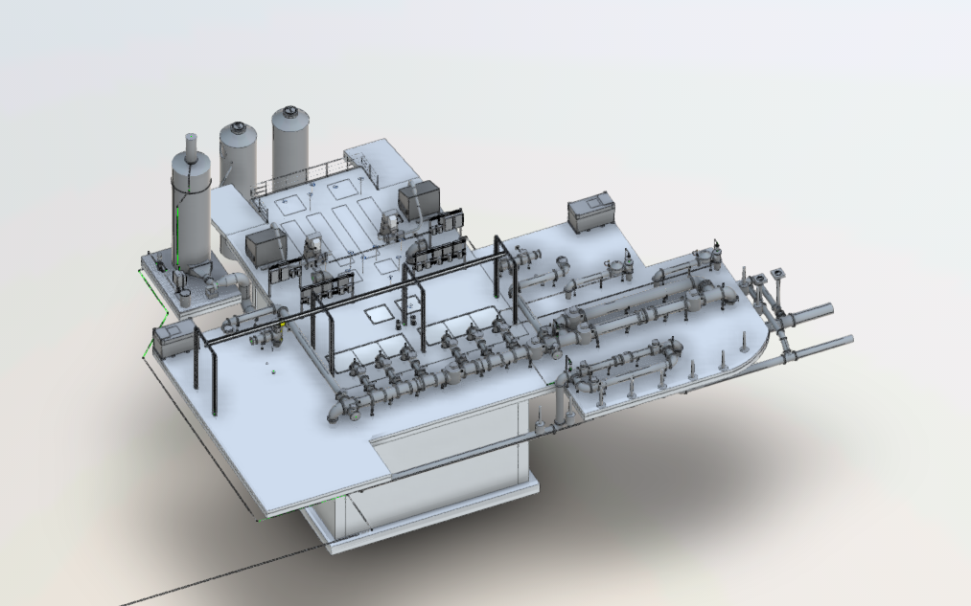
Highlight 3: The LBJ Sewershed Design Project, valued at $10.6 million, is currently 40% complete and supports the evaluation and design of the wastewater collection system from downtown Christiansted to the Pearl B. Larson School area. An additional $34 million in sewershed design projects, funded through FEMA Prudent Replacement, is scheduled to commence in 2027.
Notes:
Fiscal 2026 Total Estimated Revenue
Key Revenue Drivers and Assumptions
1. Business Compliance and License Renewals
Driver:
• A significant portion of revenue comes from business license fees, which depend on business renewals and new business registrations.
• If businesses comply with renewal deadlines, licensing revenue remains stable or increases.
• Declining renewal rates or economic downturns could result in lower revenue collection.
Assumption:
• The projections assume consistent business activity and a stable number of license renewals over the next two years.
• If more businesses fail to renew due to economic conditions, revenue could decrease.
2. Regulatory Enforcement and Penalty Fees
Driver:
• Penalty fees for delinquencies and CPS, Weights and Measures and Enforcement actions contribute to total revenue, depending on the number of violations and enforcement actions.
• The DLCA has engaged stricter enforcement practices including night-time initiatives that will yield increased citations for noncompliance. For the foreseeable future we anticipate that these actions along with improved follow-through via our legal division will lead to increased collections.
Assumption:
• The projections assume penalty fees will remain relatively stable, with no significant decline in enforcement practices.
• If compliance improves, penalty revenues may decline. Conversely, more aggressive enforcement and tighter regulations should lead to higher collections.
3. Economic Growth and Business Expansion
Driver:
• Economic conditions impact new business formation, affecting license revenue.
• A growing economy leads to more business licenses, while a recession could reduce new applications.
Assumption:
• The projections assume moderate economic stability, with a gradual increase in new business licenses at a 3.1% growth rate.
• If economic conditions worsen, business growth could slow, affecting revenue collections.
4. Department Policy and Fee Adjustments
Driver:
• For more than a decade the DLCA has resisted a wholesale increase in license fees, opting instead for a more targeted approach. Increases in license fees for alcohol related businesses were implemented with no significant retraction of licenses. We anticipate that the time is ripe for some adjustment in license fees, penalties, and payment structures which can directly impact revenue.
• An increase in fees, could lead to revenues exceeding current estimates.
Assumption:
• The projections assume no major changes in licensing fees or penalties.
• Any policy changes (such as higher license fees or increased enforcement measures) could increase revenue beyond projections.
Conclusion
The revenue projections rely on stable business activity, consistent enforcement, economic stability, and unchanged policies. Any unexpected shifts in these factors could lead to higher or lower revenues than forecasted.

Slide 91
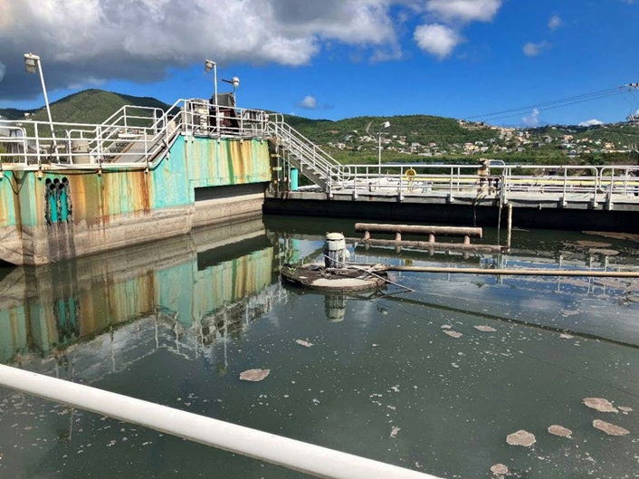
Highlight 4: The Mangrove Lagoon Wastewater Treatment Plant has an estimated construction cost of approximately $25 million, with work scheduled to begin in 2027. The project will be funded through the Bipartisan Infrastructure Law (BIL) and the EPA’s Clean Water State Revolving Fund.
Notes:
Fiscal 2026 Total Estimated Revenue
Key Revenue Drivers and Assumptions
1. Business Compliance and License Renewals
Driver:
• A significant portion of revenue comes from business license fees, which depend on business renewals and new business registrations.
• If businesses comply with renewal deadlines, licensing revenue remains stable or increases.
• Declining renewal rates or economic downturns could result in lower revenue collection.
Assumption:
• The projections assume consistent business activity and a stable number of license renewals over the next two years.
• If more businesses fail to renew due to economic conditions, revenue could decrease.
2. Regulatory Enforcement and Penalty Fees
Driver:
• Penalty fees for delinquencies and CPS, Weights and Measures and Enforcement actions contribute to total revenue, depending on the number of violations and enforcement actions.
• The DLCA has engaged stricter enforcement practices including night-time initiatives that will yield increased citations for noncompliance. For the foreseeable future we anticipate that these actions along with improved follow-through via our legal division will lead to increased collections.
Assumption:
• The projections assume penalty fees will remain relatively stable, with no significant decline in enforcement practices.
• If compliance improves, penalty revenues may decline. Conversely, more aggressive enforcement and tighter regulations should lead to higher collections.
3. Economic Growth and Business Expansion
Driver:
• Economic conditions impact new business formation, affecting license revenue.
• A growing economy leads to more business licenses, while a recession could reduce new applications.
Assumption:
• The projections assume moderate economic stability, with a gradual increase in new business licenses at a 3.1% growth rate.
• If economic conditions worsen, business growth could slow, affecting revenue collections.
4. Department Policy and Fee Adjustments
Driver:
• For more than a decade the DLCA has resisted a wholesale increase in license fees, opting instead for a more targeted approach. Increases in license fees for alcohol related businesses were implemented with no significant retraction of licenses. We anticipate that the time is ripe for some adjustment in license fees, penalties, and payment structures which can directly impact revenue.
• An increase in fees, could lead to revenues exceeding current estimates.
Assumption:
• The projections assume no major changes in licensing fees or penalties.
• Any policy changes (such as higher license fees or increased enforcement measures) could increase revenue beyond projections.
Conclusion
The revenue projections rely on stable business activity, consistent enforcement, economic stability, and unchanged policies. Any unexpected shifts in these factors could lead to higher or lower revenues than forecasted.

Slide 92
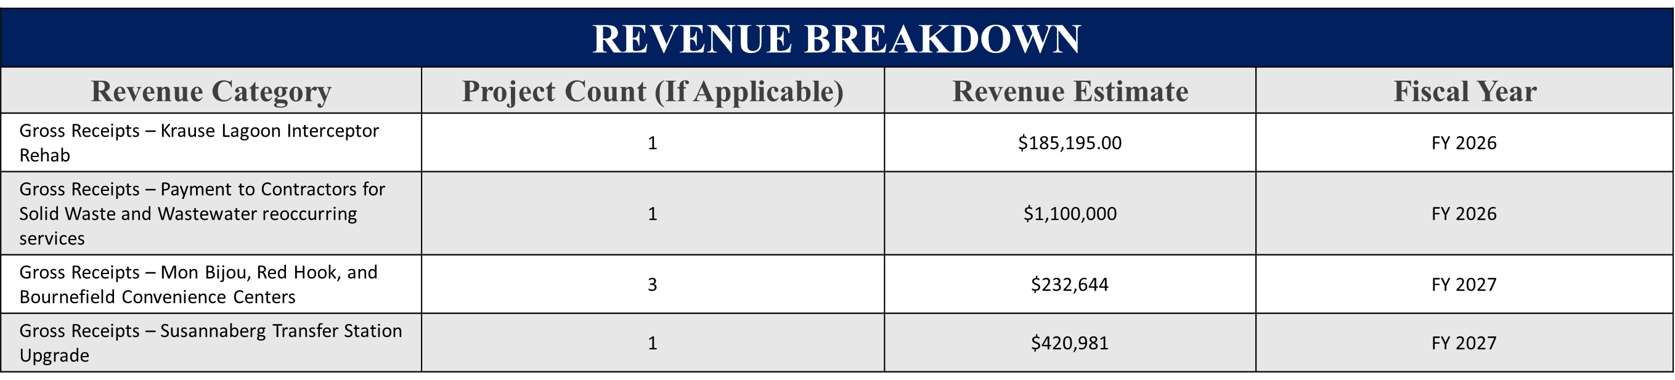
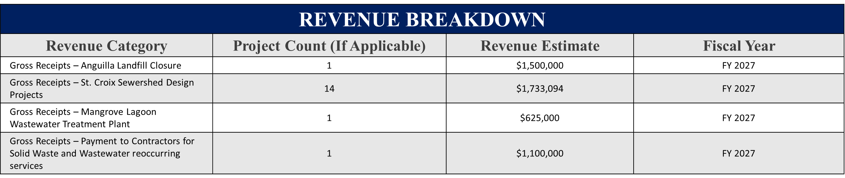
REVENUE BREAKDOWN
Revenue Category | Project Count (If Applicable) | Revenue Estimate | Fiscal Year
Gross Receipts – Concordia and Cotton Valley Convenience Centers | 2 | $148,297.35 | FY 2026
Gross Receipts - Anguilla Landfill Closure | 1 | $600,000 | FY 2026
Gross Receipts – LBJ Sewershed Design Project | 1 | $345,185 | FY 2026
Gross Receipts – C/Sted Sewer System Rehab | 1 | $83,369 | FY 2026
Notes:
Fiscal 2026 Total Estimated Revenue
Key Revenue Drivers and Assumptions
1. Business Compliance and License Renewals
Driver:
• A significant portion of revenue comes from business license fees, which depend on business renewals and new business registrations.
• If businesses comply with renewal deadlines, licensing revenue remains stable or increases.
• Declining renewal rates or economic downturns could result in lower revenue collection.
Assumption:
• The projections assume consistent business activity and a stable number of license renewals over the next two years.
• If more businesses fail to renew due to economic conditions, revenue could decrease.
2. Regulatory Enforcement and Penalty Fees
Driver:
• Penalty fees for delinquencies and CPS, Weights and Measures and Enforcement actions contribute to total revenue, depending on the number of violations and enforcement actions.
• The DLCA has engaged stricter enforcement practices including night-time initiatives that will yield increased citations for noncompliance. For the foreseeable future we anticipate that these actions along with improved follow-through via our legal division will lead to increased collections.
Assumption:
• The projections assume penalty fees will remain relatively stable, with no significant decline in enforcement practices.
• If compliance improves, penalty revenues may decline. Conversely, more aggressive enforcement and tighter regulations should lead to higher collections.
3. Economic Growth and Business Expansion
Driver:
• Economic conditions impact new business formation, affecting license revenue.
• A growing economy leads to more business licenses, while a recession could reduce new applications.
Assumption:
• The projections assume moderate economic stability, with a gradual increase in new business licenses at a 3.1% growth rate.
• If economic conditions worsen, business growth could slow, affecting revenue collections.
4. Department Policy and Fee Adjustments
Driver:
• For more than a decade the DLCA has resisted a wholesale increase in license fees, opting instead for a more targeted approach. Increases in license fees for alcohol related businesses were implemented with no significant retraction of licenses. We anticipate that the time is ripe for some adjustment in license fees, penalties, and payment structures which can directly impact revenue.
• An increase in fees, could lead to revenues exceeding current estimates.
Assumption:
• The projections assume no major changes in licensing fees or penalties.
• Any policy changes (such as higher license fees or increased enforcement measures) could increase revenue beyond projections.
Conclusion
The revenue projections rely on stable business activity, consistent enforcement, economic stability, and unchanged policies. Any unexpected shifts in these factors could lead to higher or lower revenues than forecasted.

Slide 93
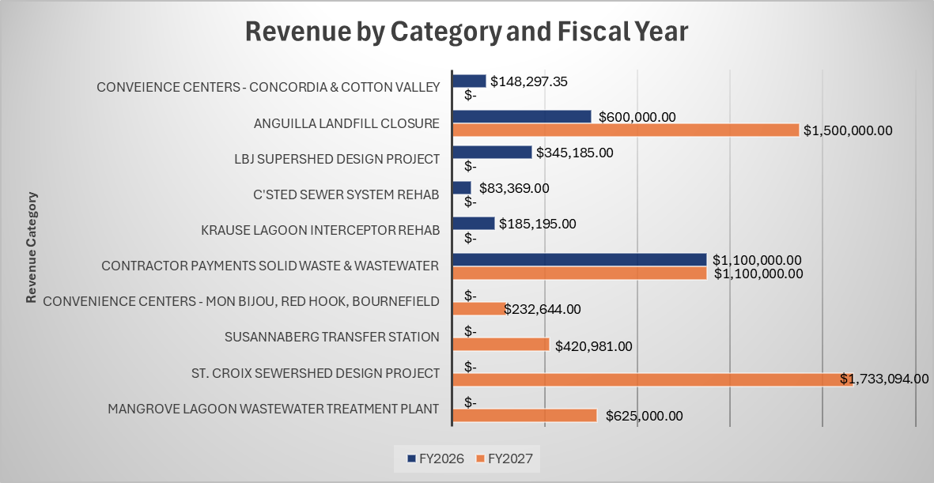
Analysis
Notes:
Key Observations
Steady Growth Trend
The total revenue has increased each year, showing a consistent upward trend.
The most significant increase occurred from FY 2021 to FY 2022, where revenues rose from $3.85 million to $4.51 million (a 17.4% increase).
This growth suggests an expansion in business licensing activities, possibly due to economic recovery, increased enforcement, or new business registrations.
Stabilization After FY 2022
The revenue increase slowed after FY 2022, with marginal growth in FY 2023 (0.5%) and FY 2024 (0.8%).
This indicates that the licensing market has matured, with fewer new businesses entering and renewals stabilizing.
Impact of External Factors
The growth in FY 2022 may have been influenced by post-pandemic economic recovery, as businesses resumed normal operations.
Regulatory changes or enforcement improvements may have contributed to better compliance and higher collections.
Projected Growth Moving Forward
The average annual growth rate across these years is 3.1%.
If this trend continues, revenues are expected to increase gradually rather than exhibit sharp growth spikes.

Slide 94
Objectives
Objective 1.
Objective 2.
The Authority has initiated the Wastewater Optimization Program, a strategic initiative that provides a structured roadmap for enhancing the reliability, sustainability, and performance of the Territory’s wastewater infrastructure through the effective use of FEMA prudent replacement funds.
VIWMA established and staffed a Director of Grants position and added four dedicated team members to strengthen the department’s capacity to manage and administer more than $100 million in grant funding annually.
Objective 3.
VIWMA remains committed to advancing critical solid waste management initiatives, ensuring full compliance with environmental regulations while strengthening and modernizing waste disposal infrastructure throughout the U.S. Virgin Islands.

Slide 95
THANK
YOU

Slide 96
2026 SPRING
REVENUE ESTIMATING CONFERENCE
MARCH 20, 2026

Slide 97
Department of Finance
Presented by
Natifah Todman & Keturah Nurse
Financial Officers

Slide 98
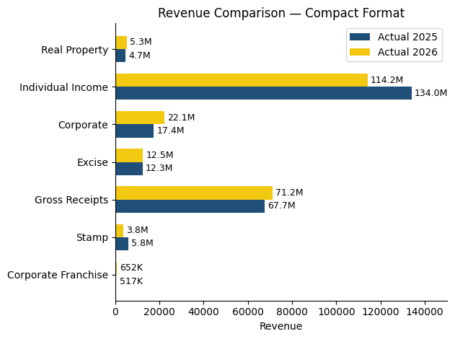



General Fund YTD Tax Collection (Actuals)

Slide 99
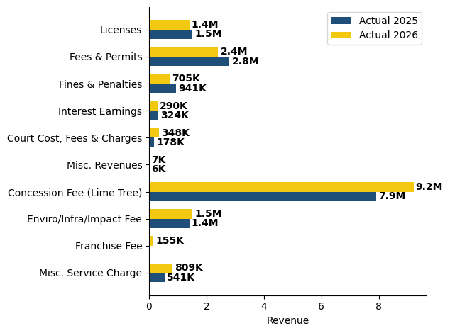


General Fund YTD Other Revenues (Actuals)
Custom Dues $3.15M

Slide 100

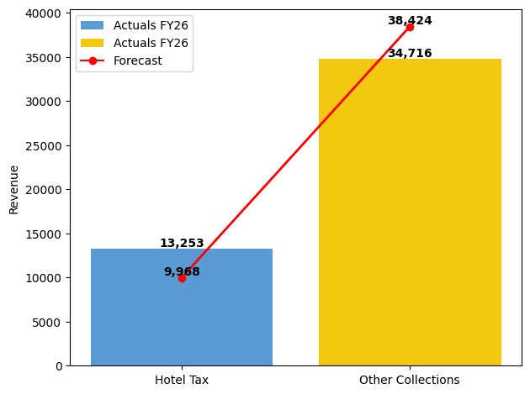
Special and Other Funds YTD Collections
CONTRIBUTORS:
Caribbean Basin
Transportation Trust Fund
Health Revolving Fund
WAPA Generator Fund
Anti-Litter & Beautification

Slide 101

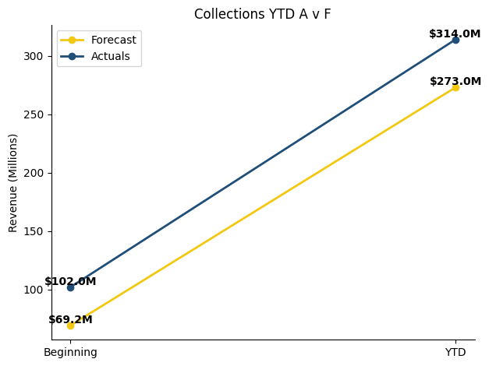
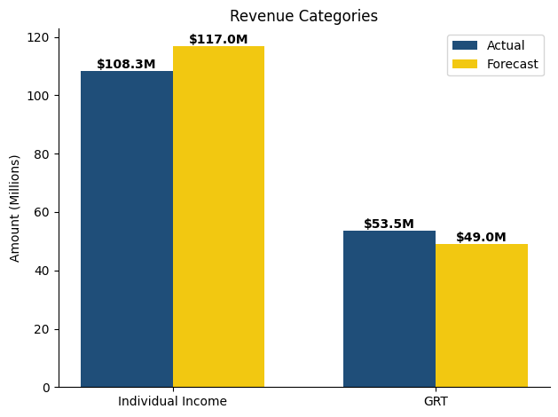
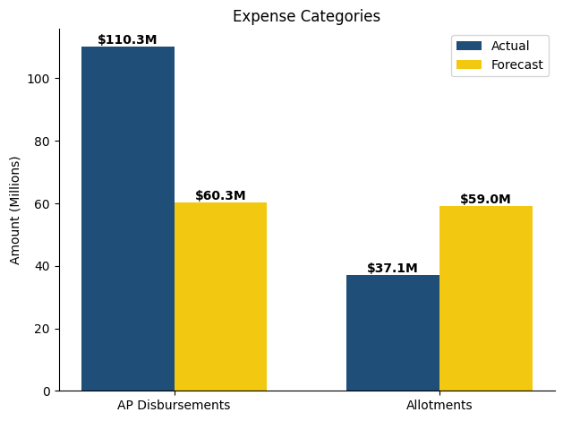
Forecast vs Actuals YTD (GF+ Other Bank 2)
Fiscal 2026 Total Estimated Revenue |  |  | Key Performance Indicators and Assumptions
FY: 26 Forecast | $273M |  | Highlight 1: Individual: (Actuals) $114M (Forecast) $117M
 |  |  | Highlight 2: GRT: (Actuals) $71.2M vs (Forecast) $49M
FY: 26 Actuals | $314M |  | Highlight 3: AP: (Actuals) $110.3M (Forecast) $60.3M
 |  |  | Highlight 4: Allotments: (Actuals) $37.1M (Forecast) $59M
15.5 days of cash-on hand vs prior year’s 9.6 days

Slide 102

General Fund Revenue Drivers
Major Decreases in Revenue
Major Increases in Revenue
REVENUE BREAKDOWN
Revenue Category | YTD
Taxes | $230M
Other Revenues | $16.4M
Other Financing Sources | $20.7M
Total Revenues: | $267M

Slide 103


OBJECTIVE
Cash on Hand: GVI maintained 15.5 days of cash on hand on a consolidated basis (General + Special Funds), based on FYTD average expenditures.
Timely Deposits: GVI’s cash position depends on agencies making deposits promptly.
Local Funds Requirement: Agencies must ensure deposit clerks submit collections within 24 hours per standard operations policies & procedures.
Federal Funds Requirement: Agencies must comply with CMIA by performing timely drawdowns.
Reference Source: S.O.P.P.s are available on the Department of Finance website.
https://dof.vi.gov/
FINANCIAL POLICIES

Slide 104


THANK
YOU

Slide 105
2026 SPRING
REVENUE ESTIMATING CONFERENCE
MARCH 20, 2026

Slide 106

Presented by
Shanisa Emmanuel
Associate Director, Financial Planning & Analysis
&
John Engerman
Fiscal and Economic Analyst

Slide 107
Objectives
Enhance Modeling of Income Tax Volatility
Integrate Macro Scenario Stress-Testing into Baseline Forecasts
Embed Demographic & Labor Force Trends into Long-Range Projections
Improve Revenue Mix Analysis & Structural Risk Monitoring

Slide 108
FY 2026 & 2027 Total Gross Estimated Revenue |  |  | Key Revenue Drivers and Assumptions
FY: 2026 | $873,870,143 |  | Income Tax Normalization following FY2025 Volatility
 |  |  | Gross Receipts Supported by Nominal Activity, Not Broad Real Expansion
FY: 2027 | $896,697,021 |  | Corporate Income Sensitive to Margin Compression & External Risk
 |  |  | Structural Constraints to Cap Medium-Term Revenue Acceleration
REVENUE BREAKDOWN
Revenue Category | FY 2025 Actuals | FY 2026 Forecast | FY 2027 Projection
Individual Income | 469,931,046 | 411,615,671 | 423,200,000
Corporate Income | 69,222,668 | 74,867,612 | 77,338,015
Other Revenues Taxes | 335,206,884 | 337,573,165 | 362,184,263
Other Revenues Fees | 44,843,224 | 38,124,170 | 46,874,923
Disclaimer: Data excludes revenues from Mitigation & Recovery.
All data subject to revision
Notes:
Fiscal 2026 Total Estimated Revenue
Key Revenue Drivers and Assumptions
1. Business Compliance and License Renewals
Driver:
• A significant portion of revenue comes from business license fees, which depend on business renewals and new business registrations.
• If businesses comply with renewal deadlines, licensing revenue remains stable or increases.
• Declining renewal rates or economic downturns could result in lower revenue collection.
Assumption:
• The projections assume consistent business activity and a stable number of license renewals over the next two years.
• If more businesses fail to renew due to economic conditions, revenue could decrease.
2. Regulatory Enforcement and Penalty Fees
Driver:
• Penalty fees for delinquencies and CPS, Weights and Measures and Enforcement actions contribute to total revenue, depending on the number of violations and enforcement actions.
• The DLCA has engaged stricter enforcement practices including night-time initiatives that will yield increased citations for noncompliance. For the foreseeable future we anticipate that these actions along with improved follow-through via our legal division will lead to increased collections.
Assumption:
• The projections assume penalty fees will remain relatively stable, with no significant decline in enforcement practices.
• If compliance improves, penalty revenues may decline. Conversely, more aggressive enforcement and tighter regulations should lead to higher collections.
3. Economic Growth and Business Expansion
Driver:
• Economic conditions impact new business formation, affecting license revenue.
• A growing economy leads to more business licenses, while a recession could reduce new applications.
Assumption:
• The projections assume moderate economic stability, with a gradual increase in new business licenses at a 3.1% growth rate.
• If economic conditions worsen, business growth could slow, affecting revenue collections.
4. Department Policy and Fee Adjustments
Driver:
• For more than a decade the DLCA has resisted a wholesale increase in license fees, opting instead for a more targeted approach. Increases in license fees for alcohol related businesses were implemented with no significant retraction of licenses. We anticipate that the time is ripe for some adjustment in license fees, penalties, and payment structures which can directly impact revenue.
• An increase in fees, could lead to revenues exceeding current estimates.
Assumption:
• The projections assume no major changes in licensing fees or penalties.
• Any policy changes (such as higher license fees or increased enforcement measures) could increase revenue beyond projections.
Conclusion
The revenue projections rely on stable business activity, consistent enforcement, economic stability, and unchanged policies. Any unexpected shifts in these factors could lead to higher or lower revenues than forecasted.

Slide 109

Analysis
5-Year View of Collections (Actuals and Estimates)
FY 2023 Actuals | FY 2024 Actuals | FY 2025 Actuals | FY 2026 Estimates | FY 2027 Estimates
$878,298,820 | $898,873,981 | $901,485,836 | $873,870,143 | $896,697,021
Post-pandemic volatility transitioning to stabilization
FY2025 peak reflects rebound dynamics; FY2026-FY2027 normalize
Moderate nominal growth outlook amid structural constraints
Disclaimer: Data excludes revenues from Mitigation & Recovery.
All data subject to revision
Notes:
Key Observations
Steady Growth Trend
The total revenue has increased each year, showing a consistent upward trend.
The most significant increase occurred from FY 2021 to FY 2022, where revenues rose from $3.85 million to $4.51 million (a 17.4% increase).
This growth suggests an expansion in business licensing activities, possibly due to economic recovery, increased enforcement, or new business registrations.
Stabilization After FY 2022
The revenue increase slowed after FY 2022, with marginal growth in FY 2023 (0.5%) and FY 2024 (0.8%).
This indicates that the licensing market has matured, with fewer new businesses entering and renewals stabilizing.
Impact of External Factors
The growth in FY 2022 may have been influenced by post-pandemic economic recovery, as businesses resumed normal operations.
Regulatory changes or enforcement improvements may have contributed to better compliance and higher collections.
Projected Growth Moving Forward
The average annual growth rate across these years is 3.1%.
If this trend continues, revenues are expected to increase gradually rather than exhibit sharp growth spikes.

Slide 110

FY2027 General Fund Projection
Disclaimer: All data is subject to revision
Notes:
Key Observations
Steady Growth Trend
The total revenue has increased each year, showing a consistent upward trend.
The most significant increase occurred from FY 2021 to FY 2022, where revenues rose from $3.85 million to $4.51 million (a 17.4% increase).
This growth suggests an expansion in business licensing activities, possibly due to economic recovery, increased enforcement, or new business registrations.
Stabilization After FY 2022
The revenue increase slowed after FY 2022, with marginal growth in FY 2023 (0.5%) and FY 2024 (0.8%).
This indicates that the licensing market has matured, with fewer new businesses entering and renewals stabilizing.
Impact of External Factors
The growth in FY 2022 may have been influenced by post-pandemic economic recovery, as businesses resumed normal operations.
Regulatory changes or enforcement improvements may have contributed to better compliance and higher collections.
Projected Growth Moving Forward
The average annual growth rate across these years is 3.1%.
If this trend continues, revenues are expected to increase gradually rather than exhibit sharp growth spikes.

Slide 111
THANK
YOU

